Slide 1
Coarse-Grained Topology Estimation via Graph Sampling
Maciej Kurant¹
Minas Gjoka²
Yan Wang²
Zack W. Almquist²
Carter T. Butts²
Athina Markopoulou²
¹ETHZ, ²UC Irvine
17 Aug 2012, WOSN

Slide 2
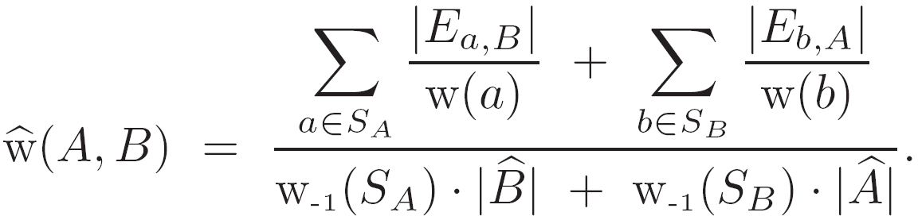
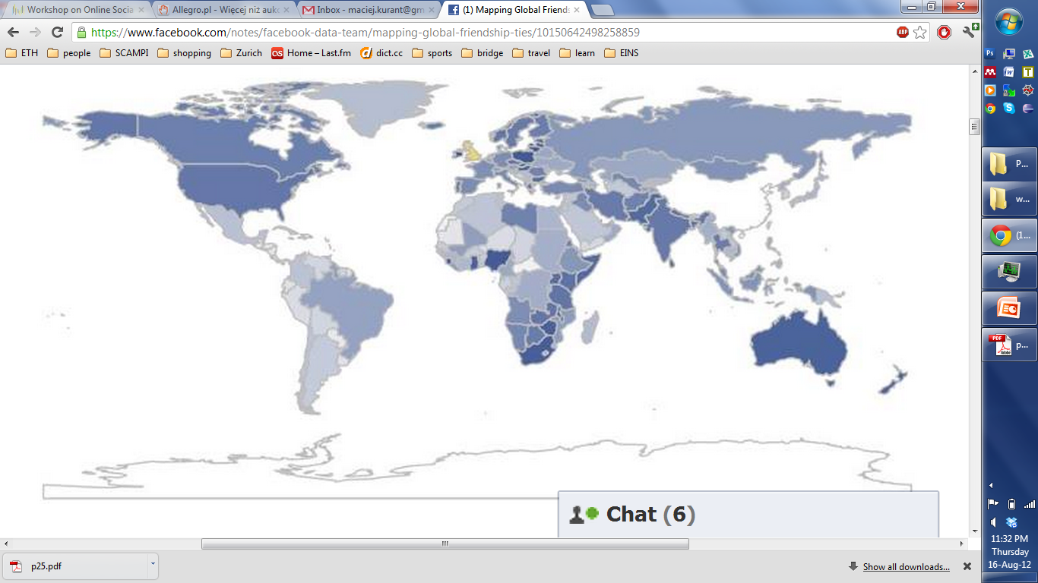
Coarse-grained topology
B
nodes belong to different categories
A
Example categories:
countries
universities
workplaces
religion
age
music genres
…
www.facebook.com/notes/facebook-data-team/mapping-global-friendship-ties/
(19 March 2012)
Notes:
factors that affect the interactions between users.

Slide 3
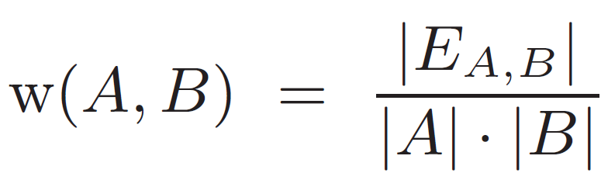
Coarse-grained topology
B
nodes belong to different categories
A
Number of edges between A and B ?
Not normalized by the size of categories!

Slide 4
Coarse-grained topology
B
nodes belong to different categories
A
Probability that a random node in A is a neighbor of a random node in B
all existing edges between A and B
all possible edges between A and B
A, B - all nodes labeled by ‘A’ and ‘B’, respectively

Slide 5

Name
School / Workplace
City or country (before 2010)
List of friends
Facebook:
800+M users
150 friends each (on average)
8 bytes (64 bits) per user ID
The raw connectivity data, with no attributes:
800 x 150 x 8B = 960 GB
To get this data, one would have to download:
200 TB of HTML data!
This is neither feasible nor practical.
Solution: Sampling!

Slide 6

Coarse-grained topology from a sample
UIS – Uniform Independence Sample
B
A
estimate
RW – Random Walk sample
B
A
Notes:
From a randomly sampled set of nodes we infer a valid topology!

Slide 7
Coarse-grained topology from a sample
UIS – Uniform Independence Sample
B
A
estimate
RW – Random Walk sample
B
A
sampling probability w(v) proportional to node degree

Slide 8
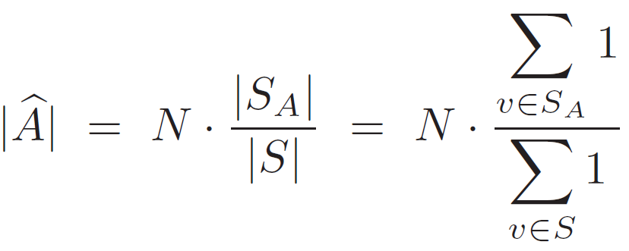
UIS
Estimating category size |A|
RW
A
N - number of nodes in the graph
A, B - all nodes labeled by ‘A’ and ‘B’, respectively
S - all sampled nodes
S_{A}, S_{B} - nodes sampled in A and B, respectively
w(v) - sampling weight of node v (under RW equal to degree of v)
Notes:
Without this correction, we:
Underestimate the relative size of India in FB by 50%
Overestimate the average node degree (number of friends) in FB by more than 200%
…

Slide 9
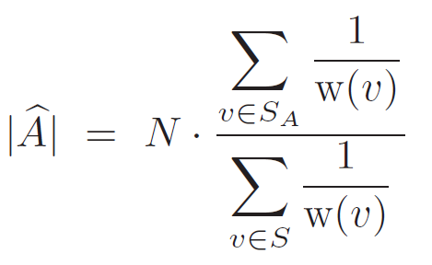
UIS
Estimating category size |A|
RW
This correction is essential!
N - number of nodes in the graph
A, B - all nodes labeled by ‘A’ and ‘B’, respectively
S - all sampled nodes
S_{A}, S_{B} - nodes sampled in A and B, respectively
w(v) - sampling weight of node v (under RW equal to degree of v)
Notes:
Without this correction, we:
Underestimate the relative size of India in FB by 50%
Overestimate the average node degree (number of friends) in FB by more than 200%
…

Slide 10
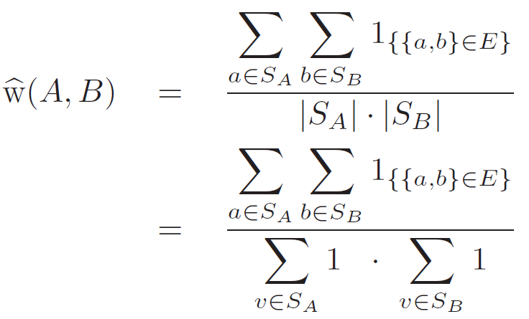
UIS
Estimating edge weights w(A,B)
(induced)
RW
(induced)
all existing edges between A and B
all possible edges between A and B
all observed edges between A and B
all edges we could have observed between A and B
A, B
N - number of nodes in the graph
A, B - all nodes labeled by ‘A’ and ‘B’, respectively
S - all sampled nodes
S_{A}, S_{B} - nodes sampled in A and B, respectively
w(v) - sampling weight of node v (under RW equal to degree of v)

Slide 11
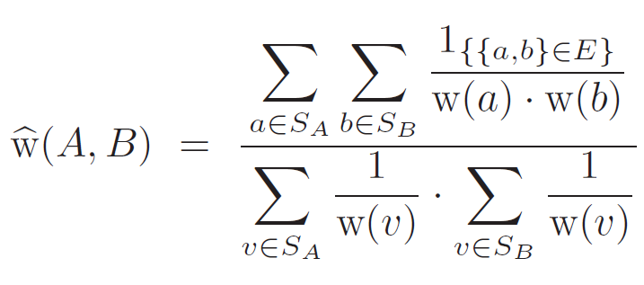
UIS
Estimating edge weights w(A,B)
(induced)
RW
N - number of nodes in the graph
A, B - all nodes labeled by ‘A’ and ‘B’, respectively
S - all sampled nodes
S_{A}, S_{B} - nodes sampled in A and B, respectively
w(v) - sampling weight of node v (under RW equal to degree of v)

Slide 12
UIS
Estimating edge weights w(A,B)
(star sampling)
RW
N - number of nodes in the graph
A, B - all nodes labeled by ‘A’ and ‘B’, respectively
S - all sampled nodes
S_{A}, S_{B} - nodes sampled in A and B, respectively
w(v) - sampling weight of node v (under RW equal to degree of v)
E_{a,B} - all edges between node a and nodes in B

Slide 13
UIS
Estimating edge weights w(A,B)
(star sampling)
RW
N - number of nodes in the graph
A, B - all nodes labeled by ‘A’ and ‘B’, respectively
S - all sampled nodes
S_{A}, S_{B} - nodes sampled in A and B, respectively
w(v) - sampling weight of node v (under RW equal to degree of v)
E_{a,B} - all edges between node a and nodes in B

Slide 14
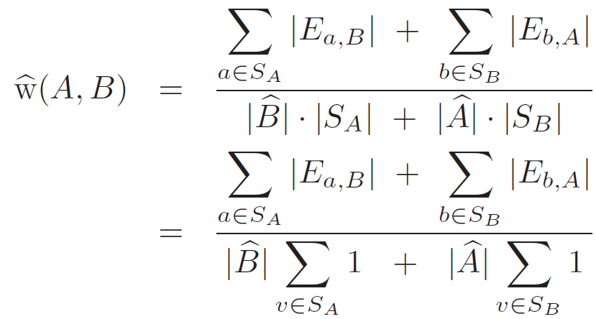
UIS
Estimating edge weights w(A,B)
(star sampling)
RW
A, B
N - number of nodes in the graph
A, B - all nodes labeled by ‘A’ and ‘B’, respectively
S - all sampled nodes
S_{A}, S_{B} - nodes sampled in A and B, respectively
w(v) - sampling weight of node v (under RW equal to degree of v)
E_{a,B} - all edges between node a and nodes in B

Slide 15
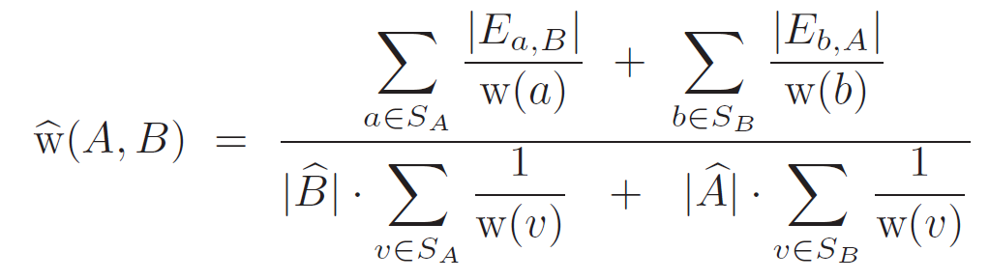
UIS
Estimating edge weights w(A,B)
(star sampling)
RW
N - number of nodes in the graph
A, B - all nodes labeled by ‘A’ and ‘B’, respectively
S - all sampled nodes
S_{A}, S_{B} - nodes sampled in A and B, respectively
w(v) - sampling weight of node v (under RW equal to degree of v)
E_{a,B} - all edges between node a and nodes in B

Slide 16
Estimators
B
A
Category size
Edge weight
induced
star
induced
star
UIS
RW
We prove the consistency of all these estimators

Slide 17
Performance evaluation

Slide 18
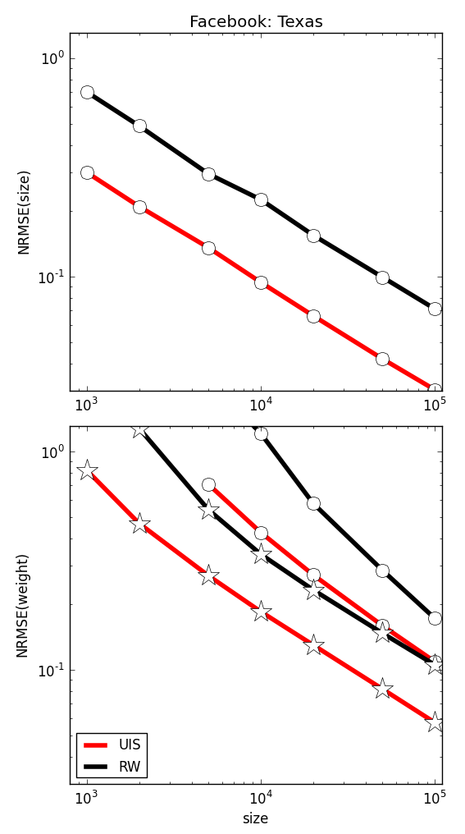

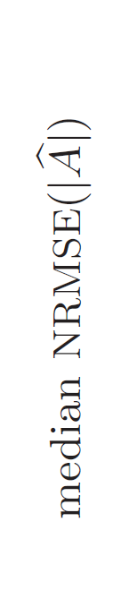
Fully known graph
Facebook: Texas
Facebook: Texas
sample size |S|
sample size |S|
Notes:
consistency
UIS is better than RW
Star sampling is several times better than induced

Slide 19
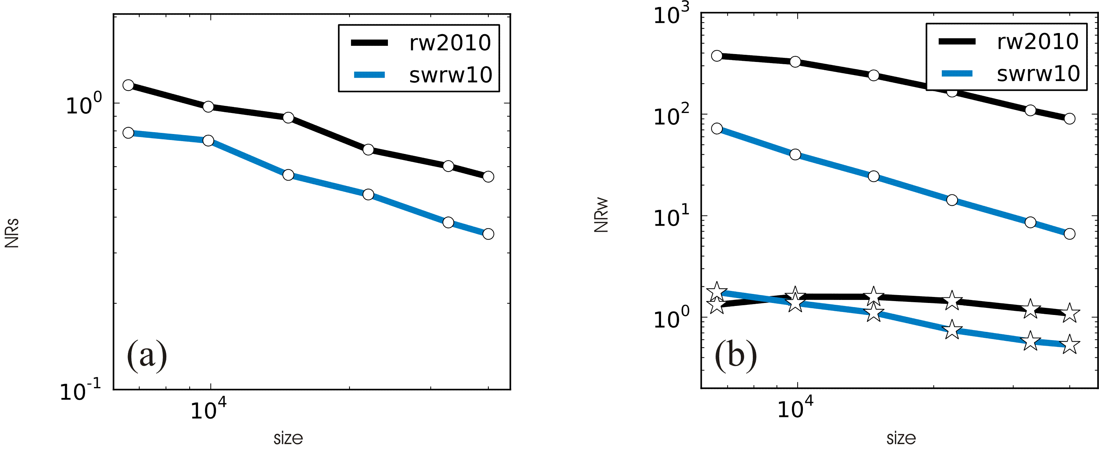
Online graph
Facebook online
Facebook online
sample size |S|
sample size |S|
[swrw10] M. Kurant, M. Gjoka, C. T. Butts and A. Markopoulou, “Walking on a Graph with a Magnifying Glass”, SIGMETRICS 2011.

Slide 20
geosocialmap.com

Slide 21
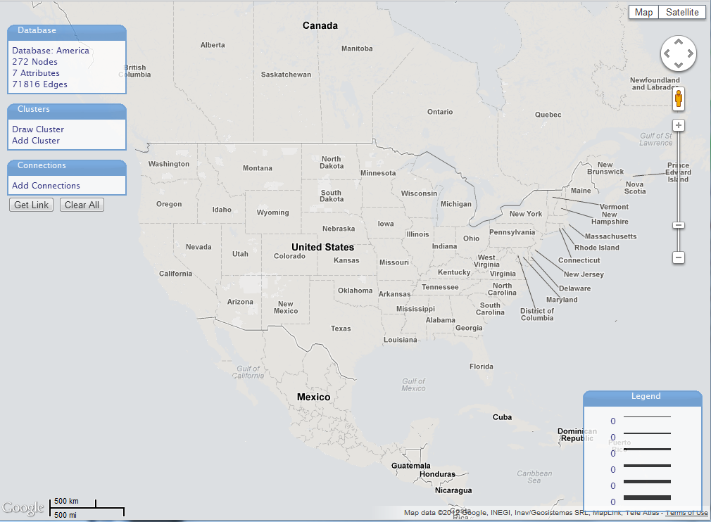
geosocialmap.com

Slide 22
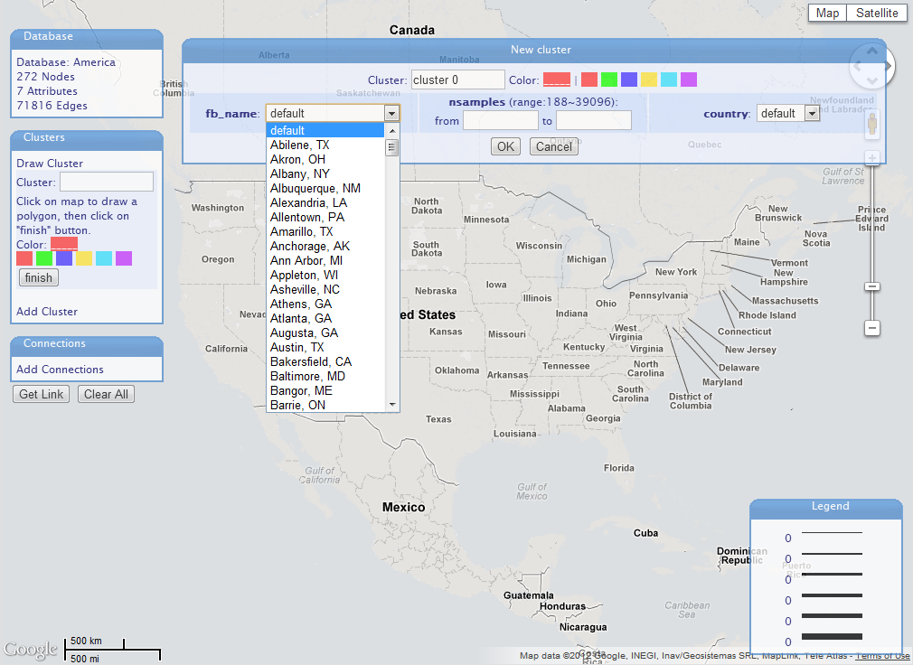
geosocialmap.com

Slide 23
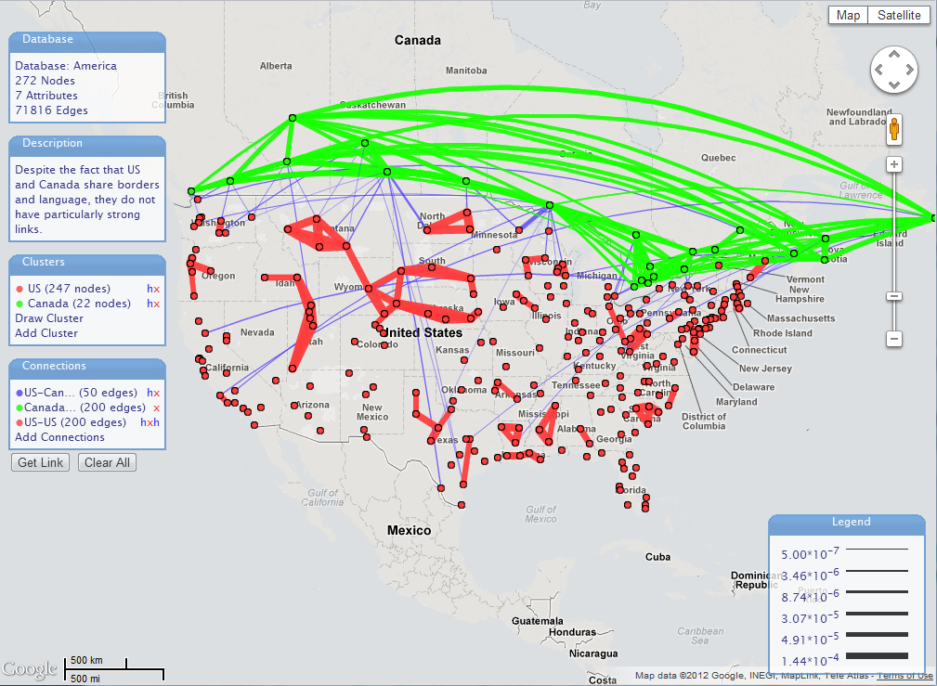
geosocialmap.com

Slide 24
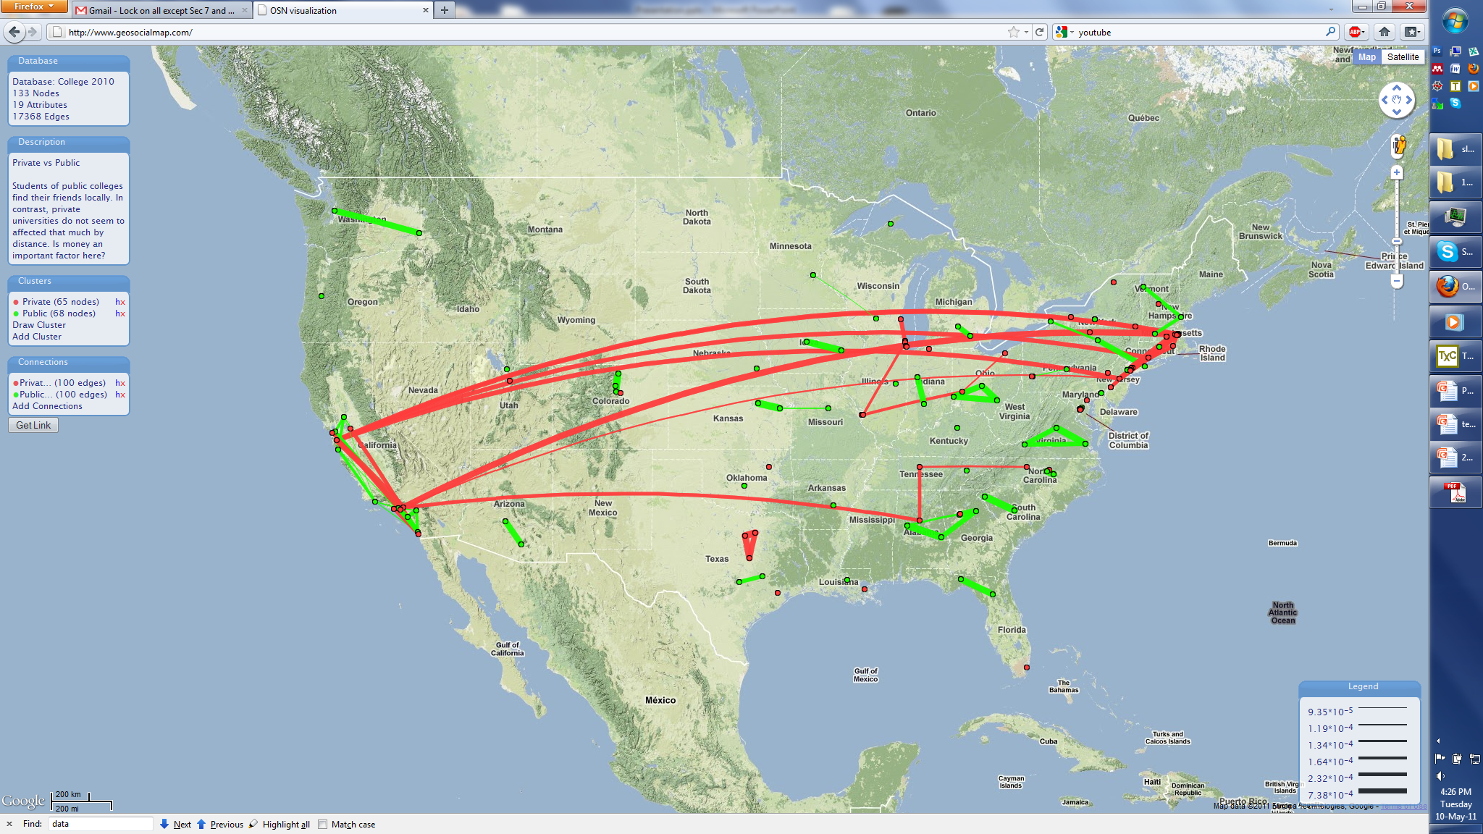
geosocialmap.com
Public and private colleges in the USA

Slide 25
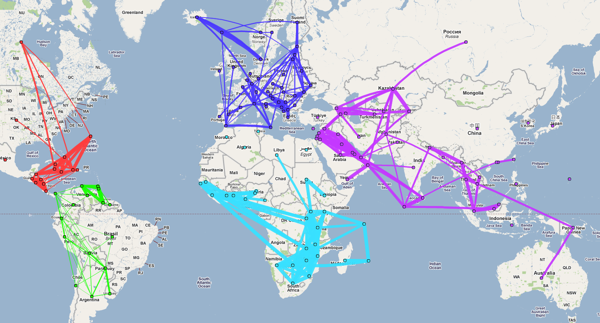
geosocialmap.com
The world according to Facebook

Slide 26
Lebanon
Jordan
Israel
Egypt
Saudi Arabia
Strong clusters among middle-eastern countries
United Arab Emirates
Notes:
Strong cliques in arabic countries

Slide 27
Summary
UIS
Original (unknown) topology
Coarse-grained topology
B
RW
A
Consistent estimators under induced and star sampling
geosocialmap.com
  Kiitos!
More info:
http://odysseas.calit2.uci.edu/osn
Notes:
From a randomly sampled set of nodes we infer a valid topology!

