Slide 1

Walking on a Graph with a Magnifying Glass
Stratified Sampling via Weighted Random Walks
Maciej Kurant
Minas Gjoka, Carter T. Butts, Athina Markopoulou
University of California, Irvine
SIGMETRICS 2011, June 11th, San Jose

Slide 2





Online Social Networks (OSNs)
Size
Traffic
500 million | 2
200 million | 9
130 million | 12
100 million | 43
75 million | 10
75 million | 29
> 1 billion users
October 2010
(over 15% of world’s population, and over 50% of world’s Internet users !)

Slide 3

Facebook:
500+M users
130 friends each (on average)
8 bytes (64 bits) per user ID
The raw connectivity data, with no attributes:
500 x 130 x 8B = 520 GB
To get this data, one would have to download:
100+ TB of (uncompressed) HTML data!
This is neither feasible nor practical.
Solution: Sampling!

Slide 4
Sampling
What:
Topology?

Slide 5
Sampling
What:
How:
Topology?
Directly?
Nodes?

Slide 6
Sampling
What:
How:
Topology?
Directly?
Nodes?
Exploration?

Slide 7
Sampling
What:
How:
Topology?
Directly?
Nodes?
Exploration?
E.g., Random Walk (RW)

Slide 8

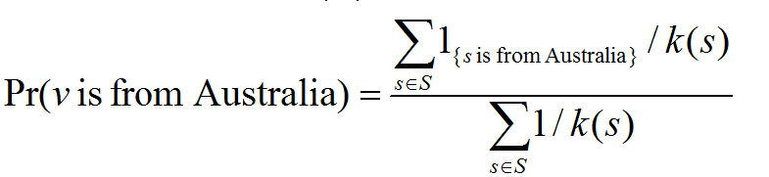
A Random Walk in Facebook
Random Walk (RW):
real
sampled
Apply the Hansen-Hurwitz estimator:
Real average node degree: 94
Observed average node degree: 338
degree of node s
[1] M. Gjoka, M. Kurant, C. T. Butts and A. Markopoulou, “Walking in Facebook: A Case Study of Unbiased Sampling of OSNs”, INFOCOM 2010.

Slide 9
Related Work
RW in online graph sampling:
  WWW [Henzinger et at. 2000, Baykan et al. 2009]
  P2P [Gkantsidis et al. 2004 , Stutzbach et al. 2006, Rasti et al. 2009]
  OSN [Rasti et al. 2008, Krishnamurthy et al, 2008, Gjoka et al. 2010]
RW mixing improvements:
  Random jumps [Henzinger et al. 2000, Avrachenkov, et al. 2010]
  Fastest Mixing Markov Chain [Boyd et al. 2004]
  Multiple dependent walks [Ribeiro et al. 2010]
  Multigraph Sampling [Gjoka et al. 2011]

Slide 10
What if the nodes are not equally important in our measurement?

Slide 11
Not all nodes are equal
Node categories:
Stratification under Weighted Independence Sampler (WIS)
(node size is proportional to its sampling probability)
important
(equally) important
irrelevant

Slide 12
Not all nodes are equal
Node categories:
Stratification under Weighted Independence Sampler (WIS)
(node size is proportional to its sampling probability)
important
(equally) important
irrelevant

Slide 13
Not all nodes are equal
Node categories:
Stratification under Weighted Independence Sampler (WIS)
(node size is proportional to its sampling probability)
Assumption:
On sampling a node, we learn categories of its neighbors.
important
(equally) important
irrelevant
But graph exploration techniques have to follow the links!
Enforcing WIS weights may lead to slow (or no) convergence
Trade-off between
ideal (WIS) sampling weights
fast convergence
  Fastest Mixing Markov Chain [Boyd et al. 2004]
Notes:
Tradeoff – already optimal weights for convergence (FMMC) is difficult (requires knowledge of the full graph)
Weight of a node is a sum of edge weights
Two main issues:
Stratification
Quick convergence

Slide 14
Initialization: Pilot Random Walk

Slide 15
Pilot Random Walk (RW)
Use classic Random Walk (RW)
Notes:
This is still very general, but probably more details cannot fit in this presentation.
Again, I would show it piece by piece (here row by row)

Slide 16
Pilot Random Walk (RW)
Use classic Random Walk (RW)
Collect a list of existing relevant and irrelevant categories
Notes:
This is still very general, but probably more details cannot fit in this presentation.
Again, I would show it piece by piece (here row by row)

Slide 17

Pilot Random Walk (RW)
Use classic Random Walk (RW)
Collect a list of existing relevant and irrelevant categories
Estimate the relative volume of each category C_{i} :
Notes:
This is still very general, but probably more details cannot fit in this presentation.
Again, I would show it piece by piece (here row by row)

Slide 18
Pilot Random Walk (RW)
Use classic Random Walk (RW)
Collect a list of existing relevant and irrelevant categories
Estimate the relative volume of each category C_{i} :
Notes:
This is still very general, but probably more details cannot fit in this presentation.
Again, I would show it piece by piece (here row by row)

Slide 19
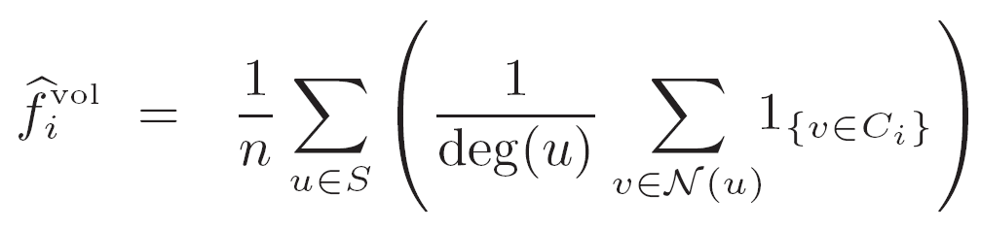
Pilot Random Walk (RW)
Use classic Random Walk (RW)
Collect a list of existing relevant and irrelevant categories
Estimate the relative volume of each category C_{i} :
RW-based estimator:
# of neighbors of u in C_{i} :
Efficient!
No need to visit C_{i} at all!
Estimation errors do not bias the ultimate measurement result (but they may increase its variance)
The size of sample S
Notes:
This is still very general, but probably more details cannot fit in this presentation.
Again, I would show it piece by piece (here row by row)

Slide 20
Stratified Weighted Random Walk

Slide 21
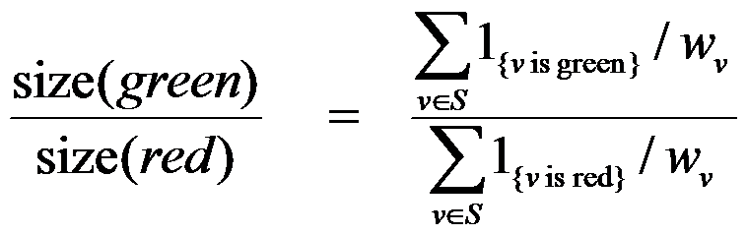
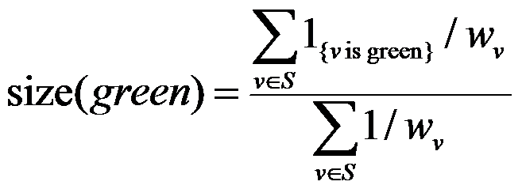
E.g., compare the size of red and green categories.
Measurement objective
Notes:
*

Slide 22
E.g., compare the size of red and green categories.
Measurement objective
Stratified sampling theory
+
Information collected by pilot RW
Category weights optimal under WIS
Notes:
This is still very general, but probably more details cannot fit in this presentation.
Again, I would show it piece by piece (here row by row)

Slide 23
E.g., compare the size of red and green categories.
Measurement objective
Category weights optimal under WIS
Modified category weights
Problem 1:
Poor or no connectivity
Problem 2:
“Black holes”
Solution:
Small weight>0 for irrelevant categories.
f* -the fraction of time we plan to spend in irrelevant nodes (e.g., 1%)
Solution:
Limit the weight of tiny relevant categories.
Γ - maximal factor by which we can increase edge weights (e.g., 100 times)
Notes:
“resolution” of our system
Gamma compared to the edge weights of the largest category

Slide 24
E.g., compare the size of red and green categories.
Measurement objective
Category weights optimal under WIS
Target edge weights:
Modified category weights
20
=
22
=
4
=
vol(green), from pilot RW *
Edge weights in G
Notes:
* pilot RW actually estimates the relative volume f^{vol}, which is enough, because if all edge weights are multiplied by a constant C then the WRW transition probabilities remain exactly the same.
This is still very general, but probably more details cannot fit in this presentation.
Again, I would show it piece by piece (here row by row)

Slide 25
E.g., compare the size of red and green categories.
Measurement objective
Category weights optimal under WIS
Target edge weights:
Modified category weights
20
=
22
=
4
=
Edge weights in G
Resolve conflicts:
arithmetic mean,
geometric mean,
max,
…
Notes:
This is still very general, but probably more details cannot fit in this presentation.
Again, I would show it piece by piece (here row by row)

Slide 26
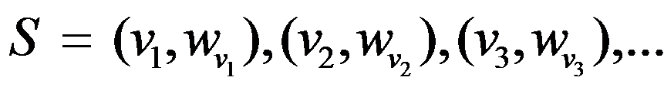
E.g., compare the size of red and green categories.
Measurement objective
Category weights optimal under WIS
Modified category weights
Edge weights in G
WRW sample
Notes:
This is still very general, but probably more details cannot fit in this presentation.
Again, I would show it piece by piece (here row by row)

Slide 27
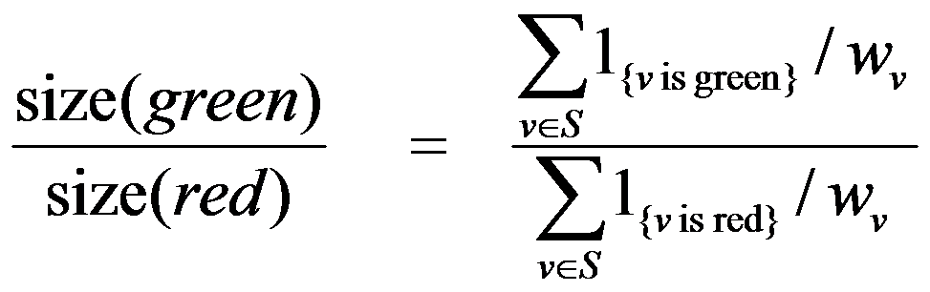
E.g., compare the size of red and green categories.
Measurement objective
Category weights optimal under WIS
Modified category weights
Edge weights in G
WRW sample
Hansen-Hurwitz estimator
Final result
Notes:
This is still very general, but probably more details cannot fit in this presentation.
Again, I would show it piece by piece (here row by row)

Slide 28
E.g., compare the size of red and green categories.
Measurement objective
Category weights optimal under WIS
Stratified Weighted Random Walk (S-WRW)
Modified category weights
Edge weights in G
WRW sample
Final result
Notes:
This is still very general, but probably more details cannot fit in this presentation.
Again, I would show it piece by piece (here row by row)

Slide 29
Simulation results

Slide 30
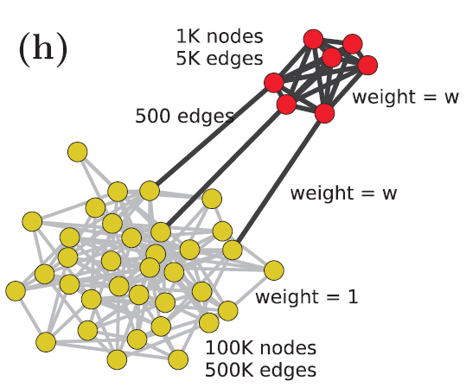
Simulation results

Slide 31
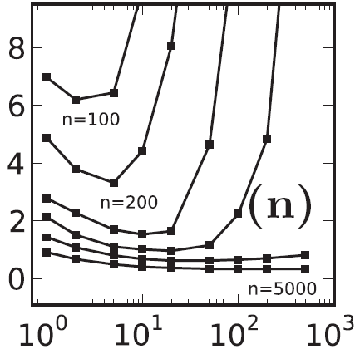
Simulation results
NRMSE(size(red))
RW
S-WRW
Uniform
WIS
weight w
Tradeoff between fast mixing (~RW) and the weights optimal under Weighted Independence Sampler (WIS)
Optimal under WIS

Slide 32
Simulation results
NRMSE(size(red))
weight w
The larger the sample size n, the closer to WIS.
Optimal under WIS

Slide 33
Evaluation on Facebook

Slide 34
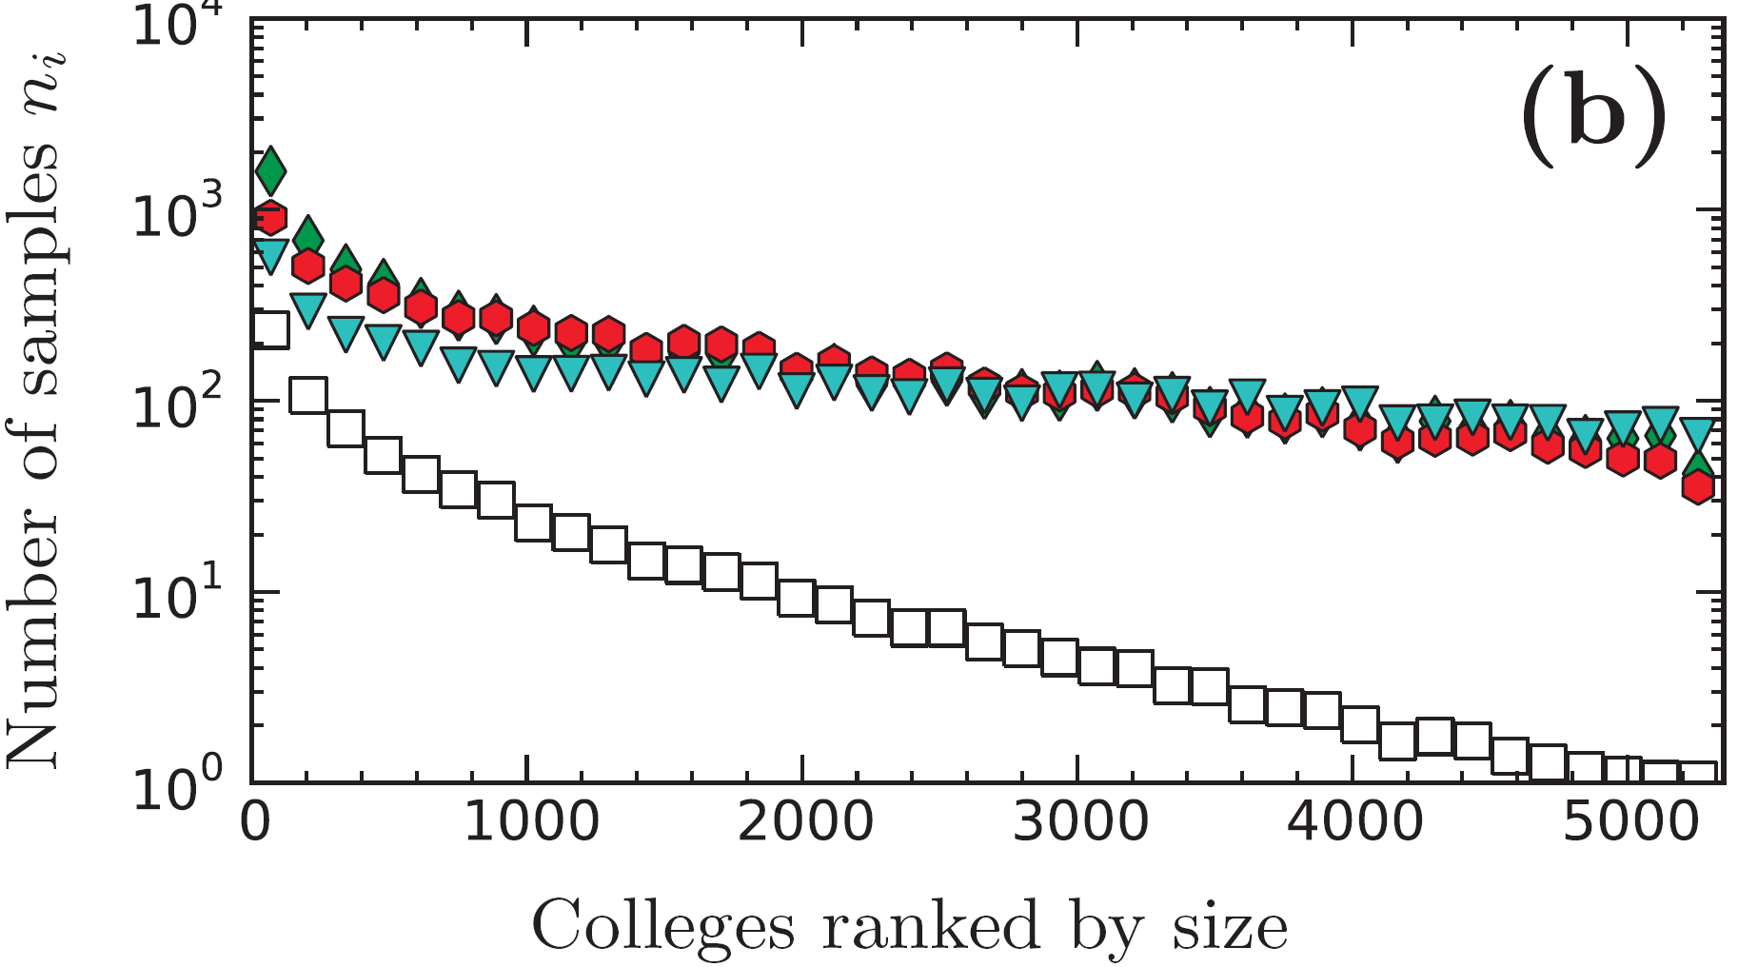
Colleges in Facebook
Samples in colleges:
86% of S-WRW, 9% of RW. This is because S-WRW avoids irrelevant categories.
The difference is larger (100x) for small colleges. This is due to S-WRW’s stratification.
versions of S-WRW
Random Walk (RW)
RW discovered 5’325 colleges. S-WRW: 8’815 (not shown)

Slide 35
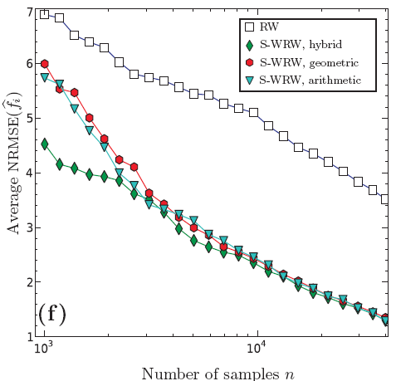
College size estimation
Random Walk (RW)
13-15 times
versions of S-WRW
RW needs about 14 times more samples to achieve the same error!
14 ~= 9 x 1.5
irrelevant categories
stratification
Notes:
NRMSE – normalized root MSE,
Average NRMSE – normalized over all colleges

Slide 36
Thank you!
Walking on a Graph with a Magnifying Glass
important
(equally) important
irrelevant
Facebook datasets available from : http://odysseas.calit2.uci.edu/osn
Example application: http://geosocialmap.com
Maciej Kurant, Minas Gjoka, Carter T. Butts and Athina Markopoulou, UC Irvine

Slide 38
Parameters
f* : the fraction of time we plan to spend in irrelevant nodes:
f*=0 iff all nodes relevant, f*>0 otherwise.
f*<<1
Exploit the pilot RW information. E.g., f* higher when relevant categories poorly interconnected
In Facebook, we used f*=1%
Γ>=1 : maximal resolution of our “graph magnifying glass”:
Let B be the size of the largest relevant category. S-WRW will typically sample well all categories whose size is at least equal to B / Γ.
Think of the smallest category that is still relevant – this gives Γ.
Set Γ smaller for smaller sample size.
Set Γ smaller in graphs with tight community structure.
In Facebook, we set Γ=1000.
In the paper, we show that S-WRW is quite robust to the choice of these parameters.

Slide 39
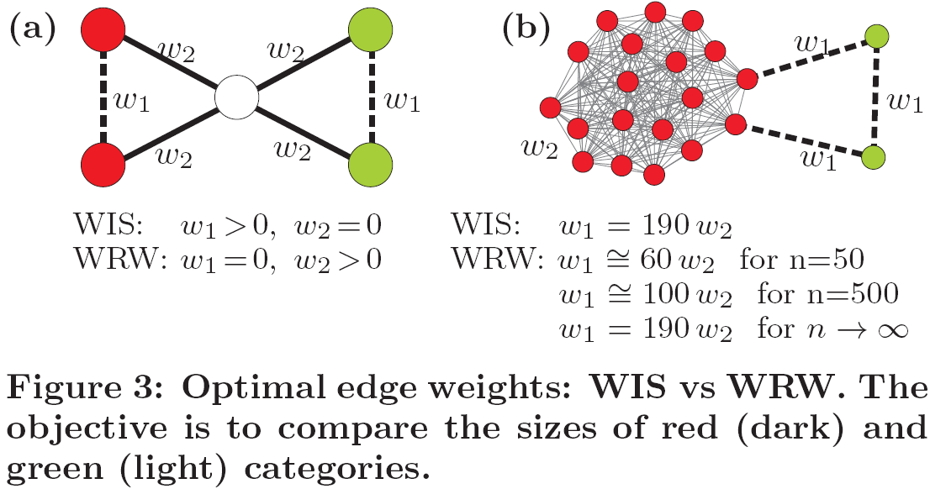
Toy graphs

