Slide 1



AntMonitor: Network Traffic Monitoring and Real-Time Prevention of Privacy Leaks in Mobile Devices
Anastasia Shuba, Anh Le, Minas Gjoka,
Janus Varmarken, Simon Langhoff, Athina Markopoulou
UC Irvine & IT Univ. Copenhagen
Notes:
Networking group at UCI, J + S at ITU

Slide 2
Mobile Traffic Growth
Cisco VNI Mobile Forecast 2014—2019

Slide 3
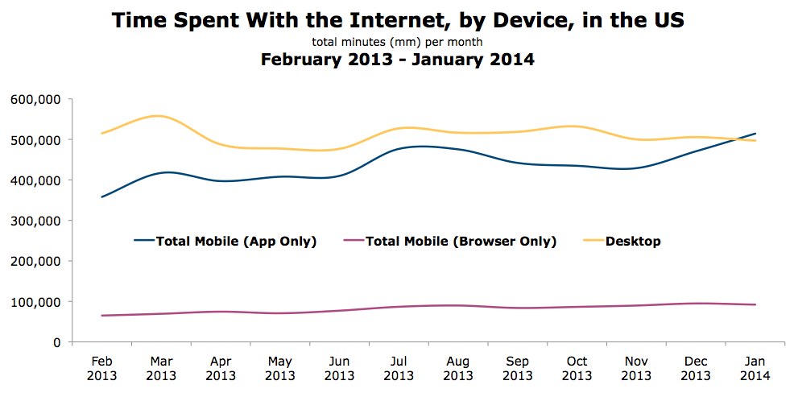
Mobile Traffic in Context
comScore Mobile Report 2014

Slide 4
Monitoring and Analyzing Mobile Traffic
ISP Traces
[Xu, IMC’11]
[Chen, IMC’12]
…
AntMonitor
Scale
User Traces
[Falaki, IMC’10] [Rodriguez, IMC’13]
…
Granularity of Information
Notes:
ISP: contextual info not existent

Slide 5

Objectives of AntMonitor
  Large-Scale Measurements
    High compatibility
  Fine-Grained Information
    Full packet trace
    Flexible annotation
  Attractive to Users
    Privacy control and protection
    High performance
    Ease of use

Slide 6

Outline
  Introduction & Motivation
  VPN Approaches
  System Design and Implementation
  Performance Evaluation
  Example Applications

Slide 7

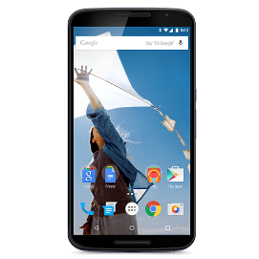




VPN-Based Approaches
AntMonitor
Collect, Analyze
Log
Server
Collect, Analyze
VPN
Server
Meddle
Collect, Analyze
tPacketCpt.
Collect

Slide 8
Outline
  Introduction & Motivation
  VPN Approaches
  System Design and Implementation
  Performance Evaluation
  Example Applications

Slide 9

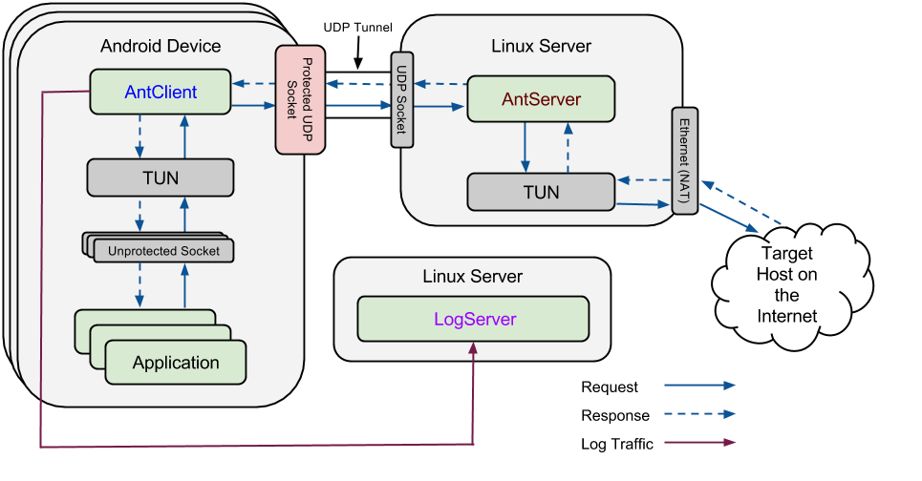
AntMonitor System

Slide 10
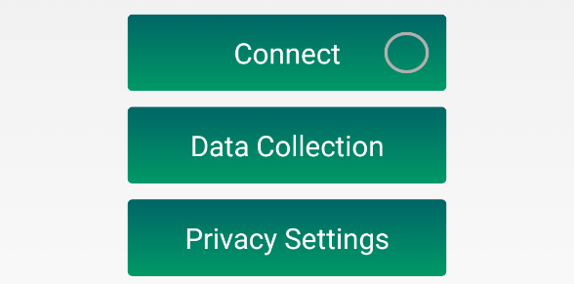
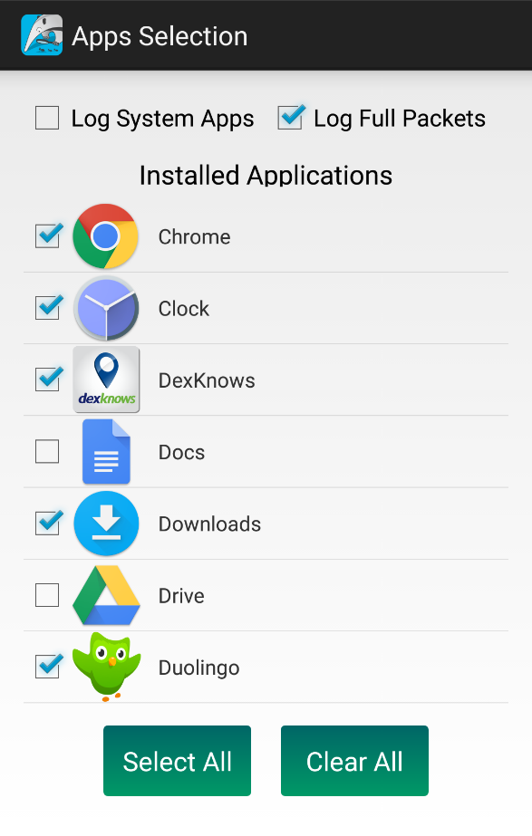
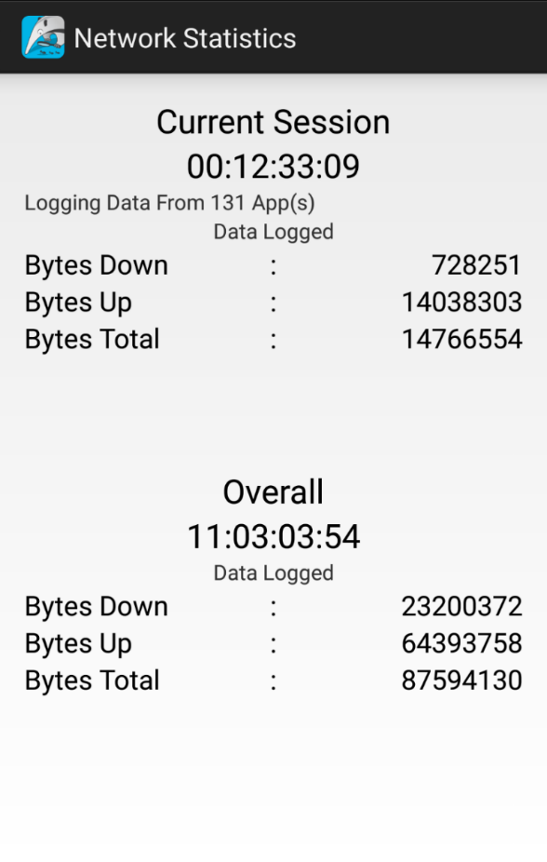
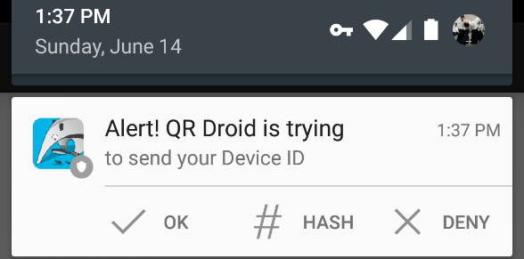
AntClient
  Compatible with 95%+ Android devices
  Fine control of contributing apps
  Log packets in PCAP-Next-Generation
  Real-time privacy leaks prevention
Notes:
Simple GUI, compatability, then other screen shots

Slide 11
Outline
  Introduction & Motivation
  VPN Approaches
  System Design and Implementation
  Performance Evaluation
  Example Applications

Slide 12
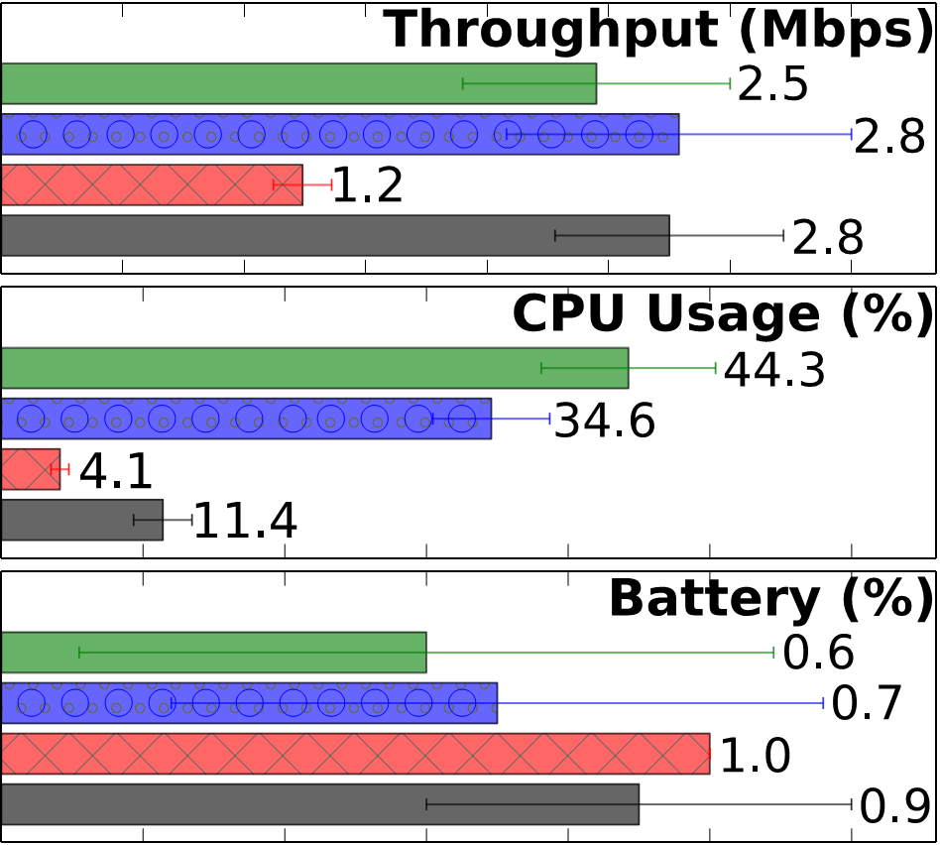
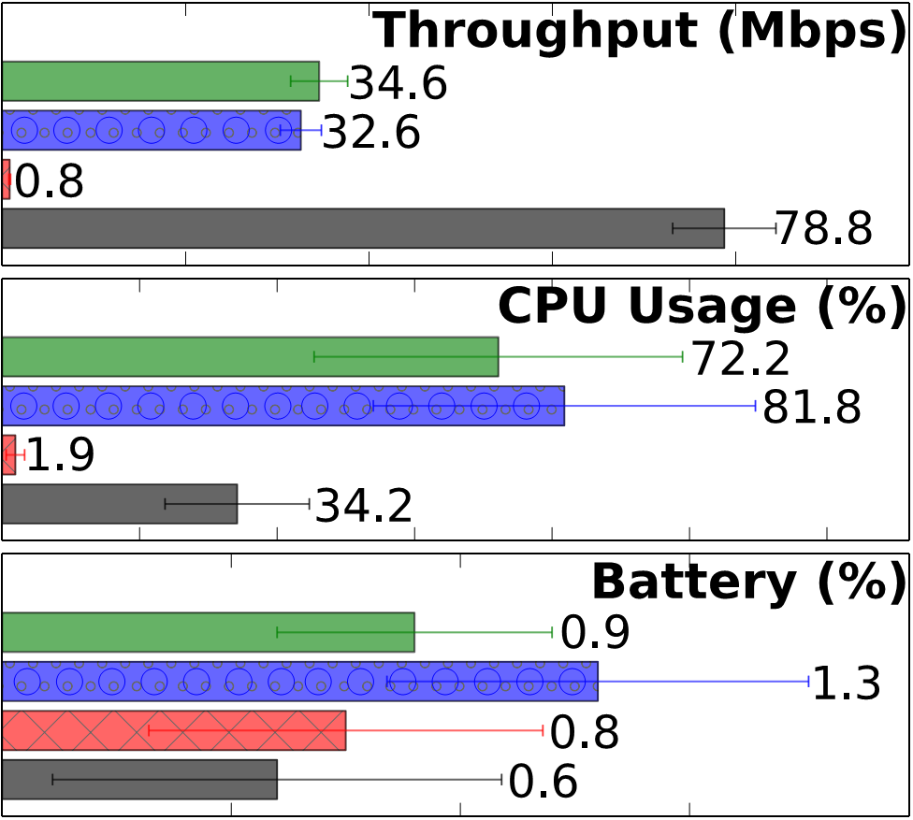
Performance Evaluation
Stress Test: Download 1 GB on Wi-Fi and 100 MB on Cellular
Typical Day

Slide 13
Outline
  Introduction & Motivation
  VPN Approaches
  System Design and Implementation
  Performance Evaluation
  Example Applications

Slide 14
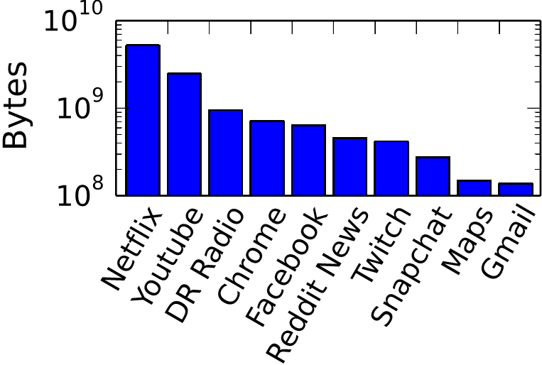
Application 1: Network Measurements
  Feb 5 – Mar 15, 2015: 9 volunteers
  1.5 GB cellular, 16 GB Wi-Fi
  95% HTTP/HTTPS
  Feb 5 – Mar 15, 2015: 9 volunteers
Top apps
Notes:
Initial side – not representative data (PILOT DEPLOYMENT) -> continuing on

Slide 15
Application 2: App Classification
Classification of network flows to apps:
  Fined-grained contextual information: ground truth
F1-score up to 70.1% using only packet header features
Previous work: precision of 64.1% using payload (host + user agent)
Top 30 Feature Categories

Slide 16
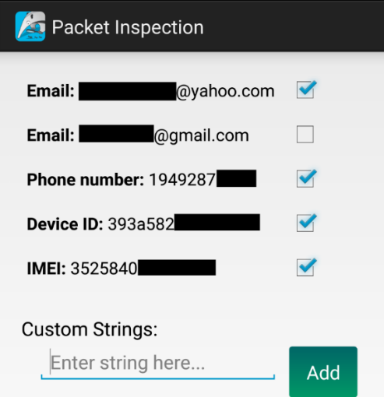
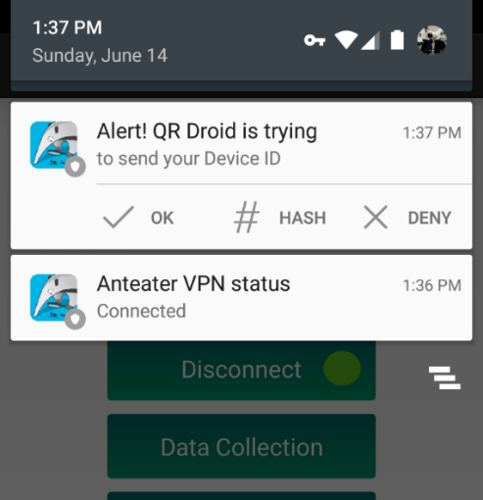
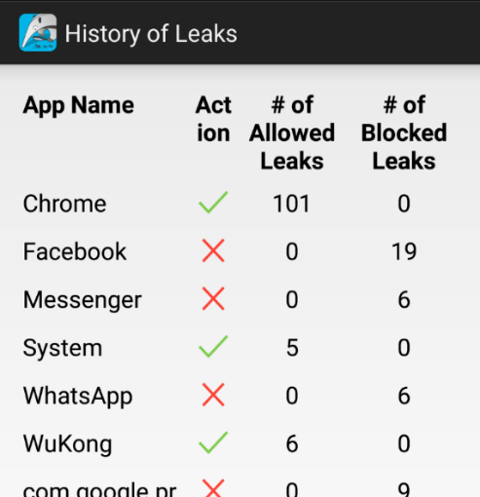
Application 3: Privacy Leak Detection
Personally Identifiable Information | # Leaking Apps | # Users
IMEI | 5 | 4
Android Device ID | 4 | 6
Phone Number | 1 | 1
Email Address | 1 | 1
Location | 1 | 2

Slide 17
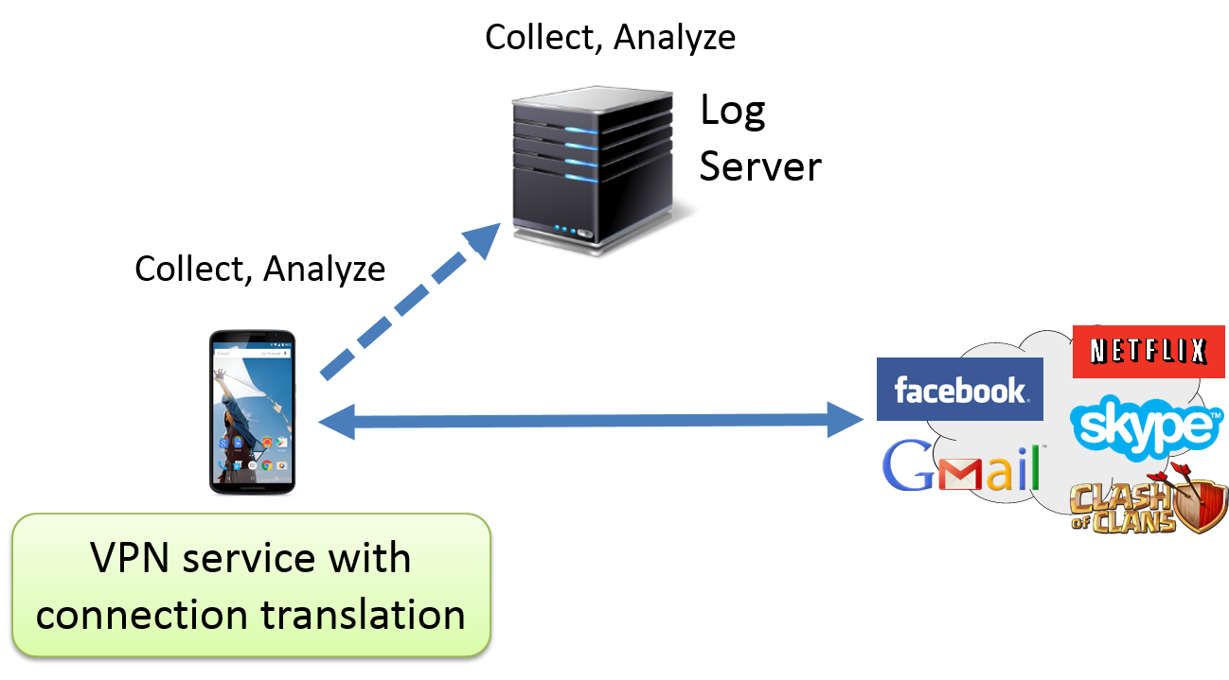
Ongoing Work
  Further improve performance, scaling, and user privacy
    Remove VPN Server and create a virtual server on the device
  Enhance real-time privacy protection
  Get more users, Google Play release

Slide 18

AntMonitor Summary
  Design for Crowdsourcing
    Large-scale measurements
    Fine-grained information
    Attractive to users
  Applications
    Network monitoring
    Application classification
    Privacy leak prevention
    …
http://antmonitor.calit2.uci.edu

Slide 19

http://antmonitor.calit2.uci.edu
Notes:
Better to

Slide 20
AntMonitor 2.0
Collect, Analyze
Log
Server
Collect, Analyze
VPN
Server
VPN service with
connection translation

Slide 21
Battery Evaluation: A Typical Day
  2014 Nielsen Survey:
  Averaging 58 minutes of app usage per day
    22 minutes of Search, Portal, and Social Apps (Facebook, Chrome)
    21 minutes of Entertainment (YouTube)
    7 minutes of Communication (Gmail)
    5 minutes of Productivity (Google Keep)
    3 minutes of News (Reddit News)
Notes:
AM: Do we have one more figure on system evaluation? We need more on systems. Maybe lessons learnt?
Back up slide for typical day.

Slide 22
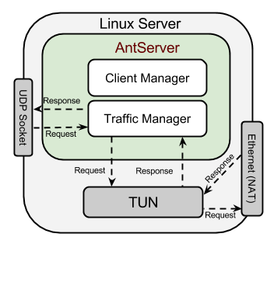
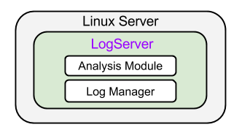
Servers
  AntServer
  Support client’s dynamic IP
    Session continuity
  High-performance
    Java: Netty asynchronous network I/O
    C++: critical components
  LogServer
  Log files automatically parsed and inserted into a database
  Global analysis
Notes:
Combine with 10 and simplify

