Slide 1
2.5K-Graphs: from Sampling to Generation
Minas Gjoka,
Maciej Kurant ‡,
Athina Markopoulou
UC Irvine, ETZH ‡

Slide 2
Motivation
Generate synthetic topologies that resemble real ones
development and testing of algorithms, protocols
anonymization
Obtaining full topology is not always possible
data owner not willing to release it
exhaustive measurement impractical due to size

Slide 3
Our methodology
Real Graph
(unknown)
Crawl using
Node Samples
UIS, WIS, RW
Estimate
Synthetic Graph
Estimated
Graph Properties
Generate

Slide 4
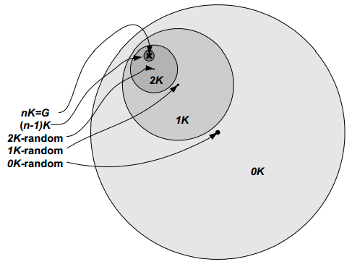
Which graph properties?
dk-series framework [Mahadevan et al, Sigcomm ’06]
0K specifies the average node degree
1K specifies the node degree distribution
2K specifies the joint node degree distribution (JDD)
3K specifies the distribution of subgraphs of 3 nodes
..
nK specifies the entire graph
Accuracy vs practicality
2.5K

Slide 5
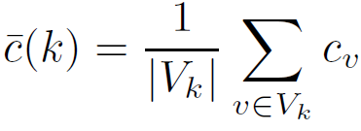
2.5K-Graphs
Joint Node Degree Distribution (2K):
Degree-dependent Average Clustering Coefficient Distribution:
all triangles using node u
all nodes of degree k
all possible triangles
2a
k
1
2
3
4
3a
4a
1
1
2
1
c_{3a} =
1
1
3
2
4b
3b
3
1
1
4
1a
1b
1
1
4
2
4

Slide 6
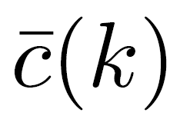
Related Work
Network Modeling
Exponential Random Graph Models [Handcock et al, ‘10]
Kronecker graphs [Kim & Leskovec, ‘11]
dk-Series [Mahadevan et al, Sigcomm ’06]
Graph Generation
Simple 1K graphs [Molloy & Reed ’95]
1K + [Bansal et. al. ’09]
1K + Triangle Sequence [Newman ’09]
1K + [Serrano & Boguna, ’05]
2K [Krioukov et. al. ‘06, Stanton & Pinar ’11]
3K [Krioukov et. al. ’06]
2.5K

Slide 7
Real Graph
(unknown)
Crawl using
Node Samples
UIS, WIS, RW
Estimate
Synthetic Graph
Estimated
c(k) & JDD
Generate

Slide 8
Estimation Node Samples
UIS – Uniform Independence Sample
WIS – Weighted Independence Sample
RW – Random Walk Sample
sampling probability w(v) proportional to node degree

Slide 9
Estimation c(k)
WIS
UIS
all triangles using node a
all possible triangles
when ((RW)
all nodes of degree k
neighbors of node a
- # shared partners for nodes (a,b)
all sampled nodes of degree k
number of samples for node b
- sampling weight of node a

Slide 10
Estimation JDD
WIS
UIS
when (RW)
- all nodes of degree k
- all edges
- all sampled nodes of degree k
- sampling weight of node a

Slide 11
Estimation Random Walks
RW
Traversed Edges
Induced Edges
with safety margin M=0
= WIS
Induced Edges with safety margin M=1
Hybrid estimator combines Traversed Edges + Induced Edges with margin M

Slide 12
Real Graph
(unknown)
Crawl using
Node Samples
UIS, WIS, RW
Estimate
Synthetic
Graph
Estimated
c(k) & JDD
Generate

Slide 13
Real Graph
(unknown)
Crawl using
Node Samples
UIS, WIS, RW
Estimate
Generate
simple graph
exact JDD
many triangles
2K
Construction
Target
JDD
2.5K Graph
Smart
Double
Edge
Swaps
Target
c(k)

Slide 14
2K Construction (1) Step 1
2K
1K
k
1
2
3
4
k
#
1
1
2
1
1
1
1
1
2
2
1
1
4
2
3
3
1
1
4
2
2
4
4

Slide 15
2K Construction (2) Step 1
1
2
3
4
2a
1
1
1
2K
1
1
2
3a
4a
3
1
1
4
1
1
4
2
4
k
#
v
k
v
4b
3b
2
1a
1
1K
1
1
1b
1
2
3
2
2a
2
1a
1b
4
2
3a
3
3b
3
4a
4
4b
4

Slide 16
2K Construction (1) Step 2
25
20
15
4a
1a
k
1
2
3
4
2a
5
1
1
3b
1
50
4b
0
2
1
1
1b
1
1
4
3a
90
3
1
1
4
2
70
4
75
2a
v
k
v
r
v
1a
1
20
3a
4a
1b
1
90
2a
2
15
3a
3
70
4b
3b
3b
3
5
4a
4
25
1a
1b
4b
5
0

Slide 17
2K Construction (2) Step 2
25
20
15
4a
1a
k
1
2
3
4
2a
5
1
1
3b
1 0
1 0
(1a,4a)
(3b,4b)
0
1
50
4b
1
1
2
1 0
1 0
(1a,2a)
(1b,4b)
1b
1
1
4
90
3 2
1 0
1 0
2 1
3
4 3
3a
(2a,3b)
(2a,4a)
1
1
4
2
3 2
1 0
1 0
2 1
4
4 3
2 0
70
75
(2a,4b)
(1a,3b)
2a
v
k
r
(1b,3b)
(3b,4a)
(1a,4b)
v
1
1a
1 0
(1b,3a)
(4a,4b)
(1b,2a)
3a
4a
1
1b
1 0
(3a,4b)
(1a,1b)
(1b,4a)
2
1 0
2a
2 1
3
(3a,3b)
(3a,4a)
(2a,3a)
2 1
4b
3a
3 2
3b
3
3 2
1 0
3b
2 1
(1a,3a)
4
3 2
2 1
4 3
4a
1 0
1a
1b
4
3 2
2 1
4b
4 3

Slide 18
2K Construction Step 3
k
1
2
3
4
Degree pair (4,3)
1
1
1 0
1 0
1
1
1
k=3
3b
3a
2
1 0
1 0
1
1
4
3 2
1 0
1 0
2 1
3
4 3
1
1
4
2
3 2
1 0
1 0
2 1
4
4 3
2 0
4b
4a
k=4
2a
v
k
v
r
1
1a
1 0
Construction stuck.
Iterate over all unsaturated degree pairs
Iterate over all unsaturated node
pairs for the degree pair (4,3)
Move 1: Add edge (4b, 3a)
Move 2: Add edge (4b,3*) or (3a,4*)
Move 3: Add edge (4*, 3*)
1
3a
4a
1b
1 0
2
1 0
2a
2 1
3
2 1
3a
3 2
4b
3b
3
3 2
1 0
3b
2 1
4
3 2
2 1
4 3
4a
1 0
4
1a
1b
3 2
2 1
4b
4 3

Slide 19
Real Graph
(unknown)
Crawl using
Node Samples
UIS, WIS, RW
Estimate
Generate
simple graph
exact JDD
many triangles
2K
Construction
Target
JDD
2.5K Graph
Smart
Double
Edge
Swaps
Target
c(k)

Slide 20
“Smart” double edge swaps 2K-preserving c(k)-targeting
Double edge swap [Mahadevan et. al., Sigcomm ‘06]
1
Destroy triangles
Current at end of 2K
k1
k1
JDD(k1,k2)
JDD(k1,k3)
unchanged
Create triangles
Target
k2
k3
degree k
How we select edges for double edge swaps
Triangle creation
select edges with low number of shared partners
Triangle destruction
select random edges

Slide 21
Evaluation
Real Graph
(unknown)
Crawl using
Node Samples
UIS, WIS, RW
Estimate
2.5K Graph
Estimated
c(k) & JDD
Generate

Slide 22
Evaluation
Total Number of Triangles
Average Clustering Coefficient
Number of
Nodes
Number of
Edges
Average
Degree

Slide 23
Evaluation Efficiency of Estimators (RW)
Facebook New Orleans
Error Metric :
Hybrid combines advantages of IE & TE

Slide 24
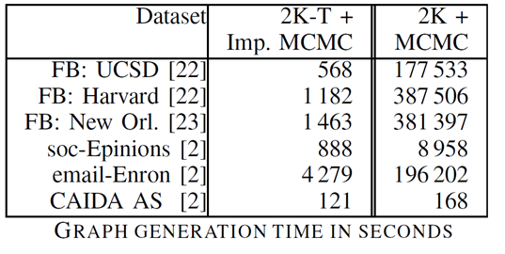
Evaluation Speed of 2.5K Graph Generation
our 2.5K
prior 2.5K
Higher gain for graphs with more triangles

Slide 25
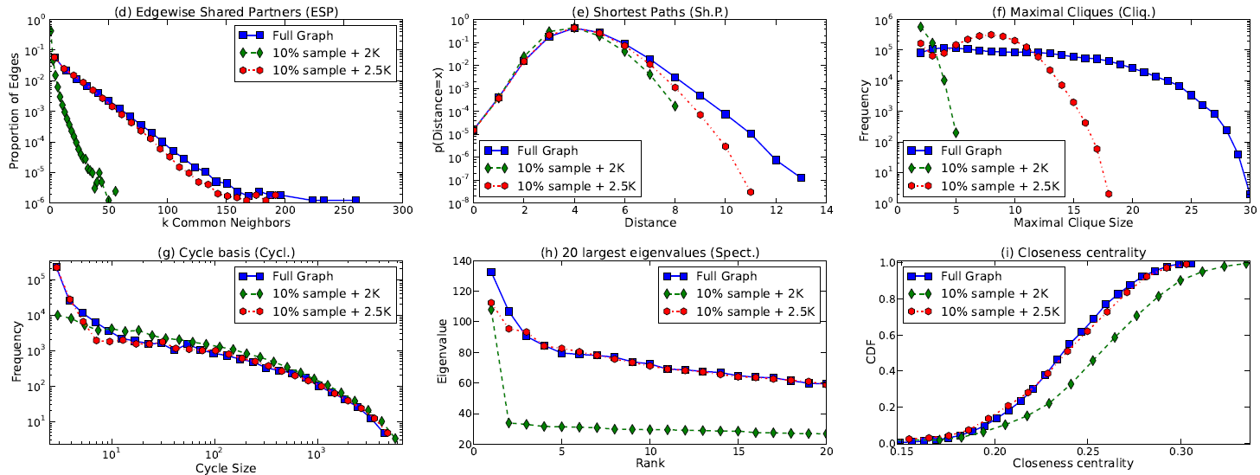
Evaluation From Sampling to Generation
Facebook New Orleans

Slide 26
Conclusion
Real Graph
(unknown)
Crawl using
Node Samples
UIS, WIS, RW
Complete and practical methodology to generate synthetic graphs from node samples
novel estimators that measure c(k) and JDD
novel and fast 2.5K generator
Python implementation
http://tinyurl.com/2-5K-Generator
Estimate
Synthetic Graph
c(k) & JDD
Generate

