Slide 1

Practical Recommendations on Crawling Online Social Networks
Minas Gjoka
Maciej Kurant
Carter Butts
Athina Markopoulou
University of California, Irvine

Slide 2





Online Social Networks (OSNs)
# Users
Traffic Rank
500 million
200 million
130 million
100 million
75 million
75 million
2
9
12
43
10
29
> 1 billion users
(Nov 2010)
(over 15% of world’s population, and over 50% of world’s Internet users !)

Slide 3
Why study Online Social Networks?
OSNs shape the Internet traffic
  design more scalable OSNs
  optimize server placements
Internet services may leverage the social graph
  Trust propagation for network security
  Common interests for personalized services
Large scale data mining
  social influence marketing
  user communication patterns
  visualization

Slide 4
Collection of OSN datasets
Social graph of Facebook:
500M users
130 friends each
8 bytes (64 bits) per user ID
The raw connectivity data, with no attributes:
500 x 130 x 8B = 520 GB
To get this data, one would have to download:
260 TB of HTML data!
This is not practical. Solution: Sampling!

Slide 5
Sampling Nodes
Estimate the property of interest from a sample of nodes

Slide 6
Population Sampling
Classic problem
  given a population of interest, draw a sample such that the probability of including any given individual is known.
Challenge in online networks
  often lack of a sampling frame: population cannot be enumerated
  sampling of users: may be impossible (not supported by API, user IDs not publicly available) or inefficient (rate limited , sparse user ID space).
Alternative: network-based sampling methods
  Exploit social ties to draw a probability sample from hidden population
  Use crawling (a.k.a. “link-trace sampling”) to sample nodes

Slide 7
Sample Nodes by Crawling

Slide 8
Sample Nodes by Crawling

Slide 9
Sampling Nodes
Questions:
How do you collect a sample of nodes using crawling?
What can we estimate from a sample of nodes?

Slide 10
Related Work
Graph traversal (BFS, Snowball)
  A. Mislove et al, IMC 2007
  Y. Ahn et al, WWW 2007
  C. Wilson, Eurosys 2009
Random walks (MHRW, RDS)
  M. Henzinger et al, WWW 2000
  D. Stutbach et al, IMC 2006
  A. Rasti et al, Mini Infocom 2009

Slide 11
How do you crawl Facebook?
Before the crawl
  Define the graph (users, relations to crawl)
  Pick crawling method for lack of bias and efficiency
  Decide what information to collect
  Implementation: efficient crawlers, access limitations
During the crawl
  When to stop? Online convergence diagnostics
After the crawl
  What samples to discard?
  How to correct for the bias, if any?
  How to evaluate success? ground truth?
  What can we do with the collected sample (of nodes)?

Slide 12
Crawling Method 1:
Breadth-First-Search (BFS)
Starting from a seed, explores all neighbors nodes. Process continues iteratively
Sampling without replacement.
BFS leads to bias towards high degree nodes
Lee et al, “Statistical properties of Sampled Networks”, Phys Review E, 2006
Early measurement studies of OSNs use BFS as primary sampling technique
i.e [Mislove et al], [Ahn et al], [Wilson et al.]

Slide 13
Crawling Method 2:
Simple Random Walk (RW)
Randomly choose a neighbor to visit next
(sampling with replacement)
leads to stationary distribution
RW is biased towards high degree nodes
Degree of node υ

Slide 14


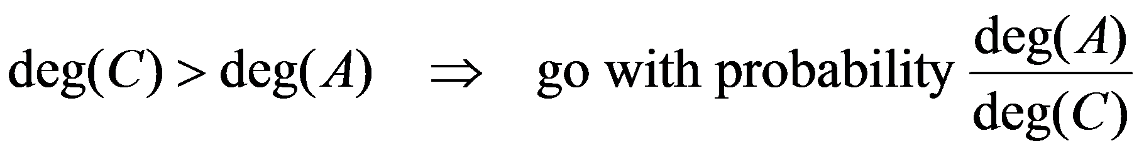
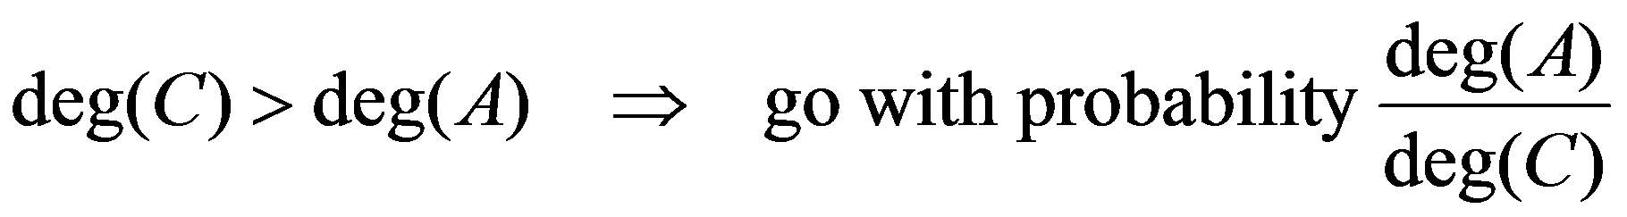
Correcting for the bias of the walk
Crawling Method 3:
Metropolis-Hastings Random Walk (MHRW):
E
I
N
D
G
K
B
M
H
A
L
C
J
F
D
A
A
C
…
…

Slide 15
Correcting for the bias of the walk
Crawling Method 3:
Metropolis-Hastings Random Walk (MHRW):
Crawling Method 4:
Re-Weighted Random Walk (RWRW):
E
I
N
D
G
K
B
M
H
A
L
C
J
F
D
A
A
C
…
Now apply the Hansen-Hurwitz estimator:
…
15

Slide 16
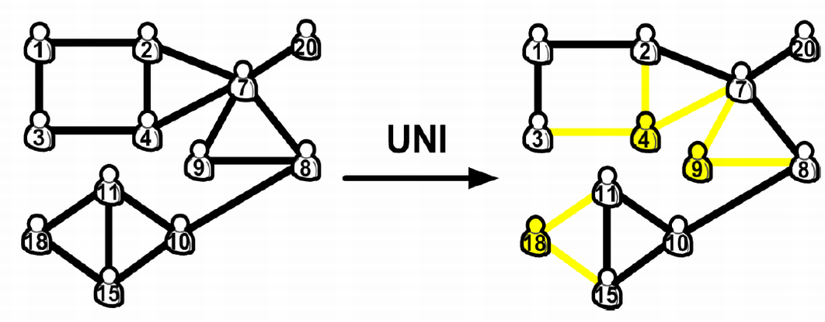
Uniform userID Sampling (UNI)
As a basis for comparison, we collect a uniform sample of Facebook userIDs (UNI)
  rejection sampling on the 32-bit userID space
UNI not a general solution for sampling OSNs
  userID space must not be sparse

Slide 17
Data Collection
Sampled Node Information
What information do we collect for each sampled node u?

Slide 18
Data Collection
Challenges
Facebook not an easy website to crawl
  rich client side Javascript
  stronger than usual privacy settings
  limited data access when using API
  unofficial rate limits that result in account bans
  large scale
  growing daily
Designed and implemented OSN crawlers

Slide 19
Data Collection
Parallelization
Distributed data fetching
  cluster of 50 machines
  coordinated crawling
Multiple walks/traversals
  RW, MHRW, BFS
Per walk
  multiple threads
  limited caching (usually FIFO)

Slide 20
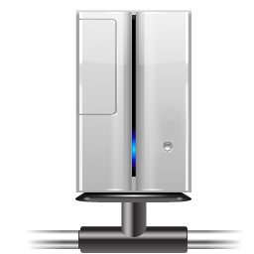
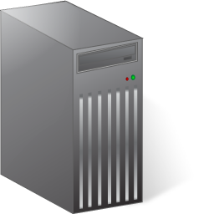
Data Collection
BFS
Seed nodes
Queue
Pool of threads
…
1
2
n
…
Visited
User Account
Server

Slide 21
Summary of Datasets
April-May 2009
Sampling method | MHRW | RW | BFS | UNI
#Valid Users | 28x81K | 28x81K | 28x81K | 984K
# Unique Users | 957K | 2.19M | 2.20M | 984K
MHRW & UNI datasets publicly available
  more than 500 requests
  http://odysseas.calit2.uci.edu/osn

Slide 22
Detecting Convergence
Number of samples to lose dependence from seed nodes (or burn-in)
Number of samples to declare the sample sufficient
Assume no ground truth available

Slide 23
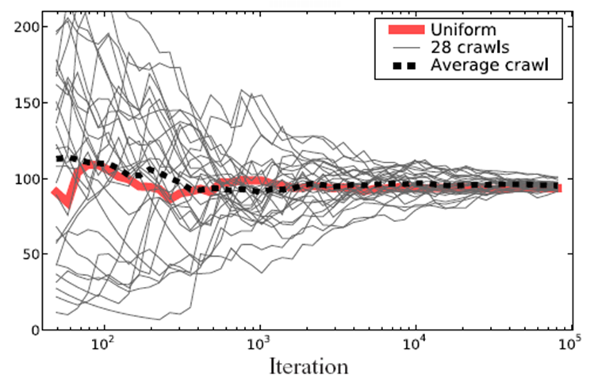
Detecting Convergence
Running means
Average node degree
MHRW

Slide 24
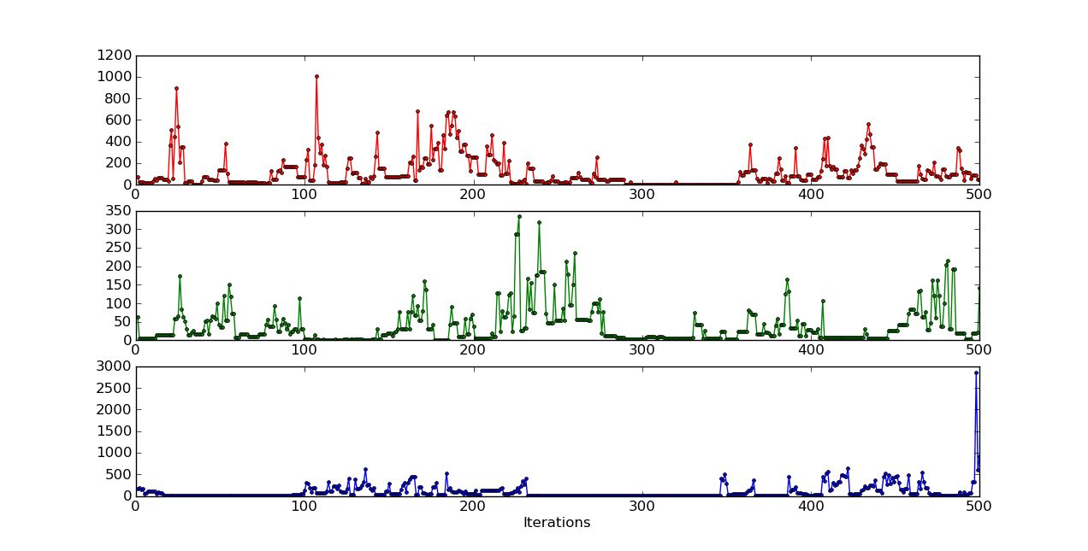
Online Convergence Diagnostics
Gelman-Rubin
Detects convergence for m>1 walks
A. Gelman, D. Rubin, “Inference from iterative simulation using multiple sequences“ in Statistical Science Volume 7, 1992
Between walks
variance
Walk 1
Node degree
Walk 2
Walk 3
Within walks
variance

Slide 25
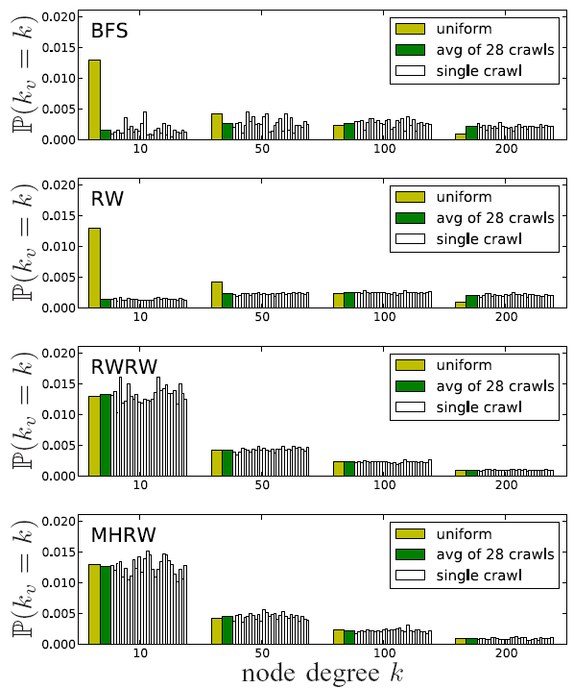
Methods Comparison
Node Degree
Poor performance for BFS, RW
MHRW, RWRW produce good estimates
  per chain
  overall
28 crawls

Slide 26
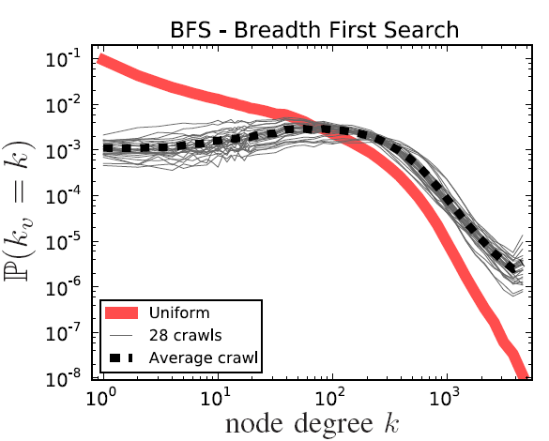
Sampling Bias
Node Degree
 | Average | Median
BFS | 323 | 208
UNI | 94 | 38
BFS is highly biased

Slide 27
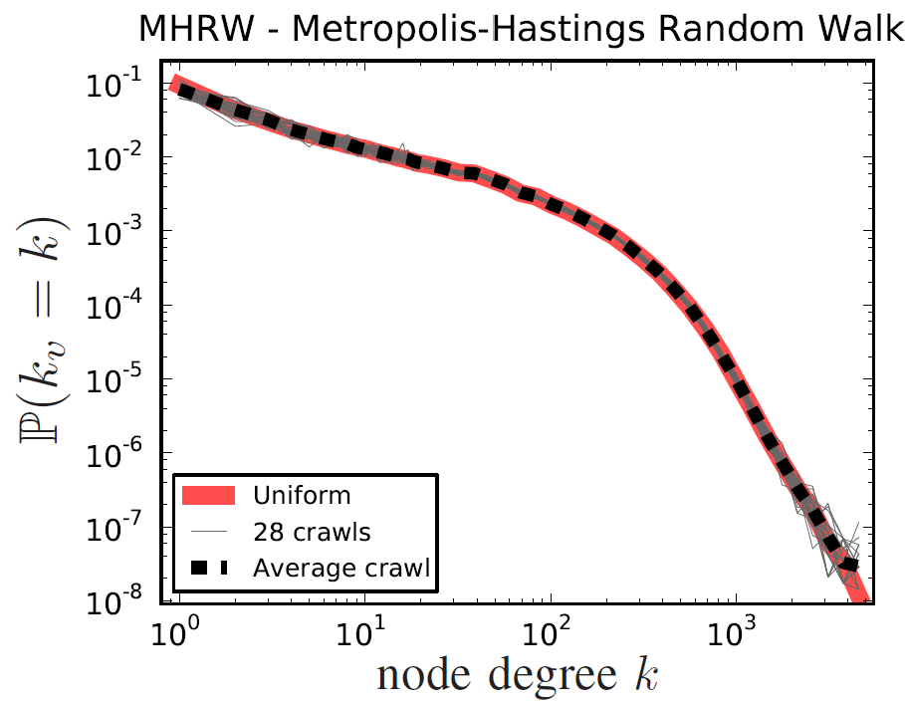
Sampling Bias
Node Degree
 | Average | Median
MHRW | 95 | 40
UNI | 94 | 38
Degree distribution of MHRW identical to UNI

Slide 28
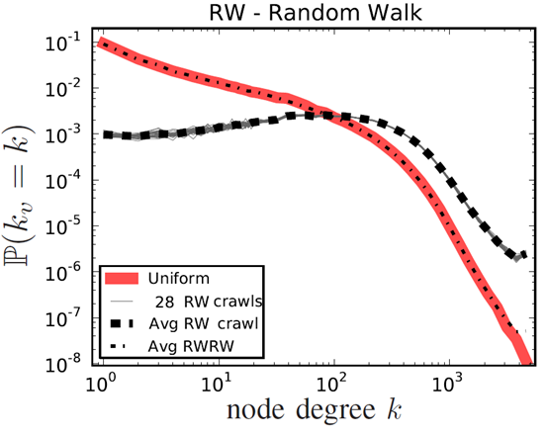
Sampling Bias
Node Degree
 | Average | Median
RW | 338 | 234
RWRW | 94 | 39
UNI | 94 | 38
RW as biased as BFS but with smaller variance in each walk
Degree distribution of RWRW identical to UNI

Slide 29
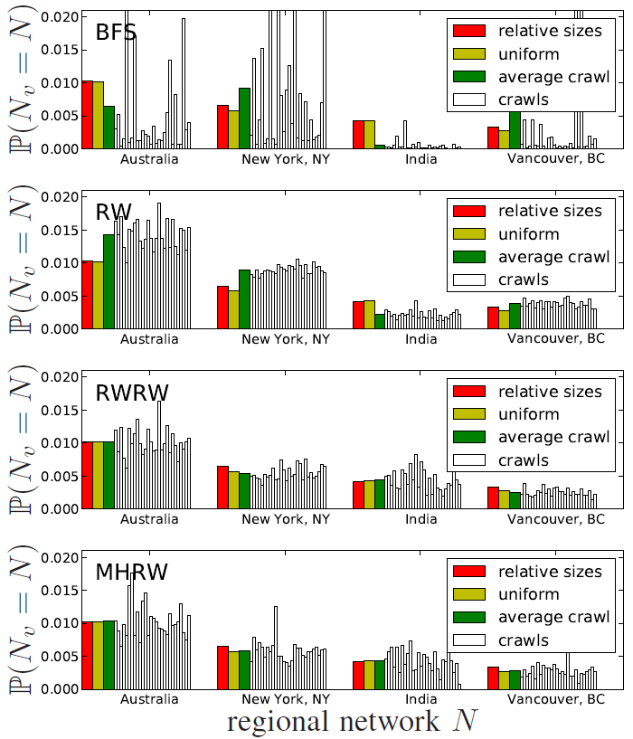
Sampling Bias
Network Membership
28
crawls
28
crawls
28
crawls
28
crawls

Slide 30
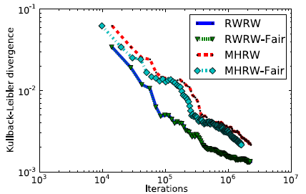
Estimation error comparison
MHRW vs RWRW

Slide 31
Graph Sampling Methods
Practical Recommendations
Use MHRW or RWRW. Do not use BFS, RW.
Use formal convergence diagnostics
  multiple parallel walks
  assess convergence online
MHRW vs RWRW
  RWRW slightly better performance
  MHRW provides a “ready-to-use” sample

Slide 32
What can we infer based on probability sample of nodes?
Any node property
  Frequency of nodal attributes
    Personal data: gender, age, name etc…
    Privacy settings : it ranges from 1111 (all privacy settings on) to 0000 (all privacy settings off)
    Membership to a “category”: university, regional network, group
  Local topology properties
    Degree distribution
    Assortativity (extended egonet samples)
    Clustering coefficient (extended egonet samples)

Slide 33
Privacy Awareness in Facebook
PA =
Probability that a user changes the default (off) privacy settings

Slide 34
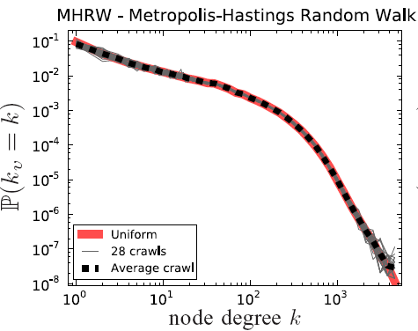
Facebook Social Graph
Degree Distribution
ª1^{=1.32}
ª2^{=3.38}
Degree distribution not a power law

Slide 35
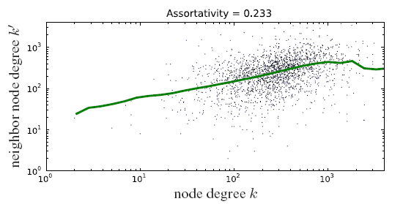
Facebook Social Graph
Assortativity
[Wilson09] Assortativity Coefficient = 0.17

Slide 36
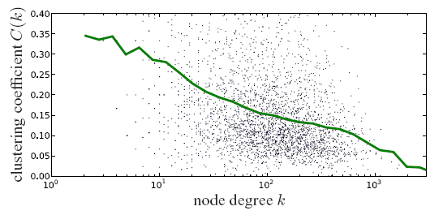
FB Social Graph
Clustering coefficient
[Wilson09] C(k) range is [0.05, 0.18]

Slide 37
Conclusion
Compared graph crawling methods
  MHRW, RWRW performed remarkably well
  BFS, RW lead to substantial bias
Practical recommendations
  usage of online convergence diagnostics
  proper use of multiple chains
MHRW & UNI datasets publicly available
  more than 500 requests
  http://odysseas.calit2.uci.edu/osn
M. Gjoka, M. Kurant, C. T. Butts, A. Markopoulou, “Practical Recommendations on Crawling Online Social Networks”, JSAC special issue on Measurement of Internet Topologies, Vol.29, No. 9, Oct. 2011

