Slide 1

Link-Trace Sampling for Social Networks:
Advances and Applications
Maciej Kurant (UC Irvine)
Join work with:
Minas Gjoka (UC Irvine),
Athina Markopoulou (UC Irvine),
Carter T. Butts (UC Irvine),
Patrick Thiran (EPFL).
Presented at Sunbelt Social Networks Conference February 08-13, 2011.

Slide 2





Online Social Networks (OSNs)
Size
Traffic
500 million | 2
200 million | 9
130 million | 12
100 million | 43
75 million | 10
75 million | 29
> 1 billion users
October 2010
(over 15% of world’s population, and over 50% of world’s Internet users !)

Slide 3

Facebook:
500+M users
130 friends each (on average)
8 bytes (64 bits) per user ID
The raw connectivity data, with no attributes:
500 x 130 x 8B = 520 GB
To get this data, one would have to download:
260 TB of HTML data!
This is neither feasible nor practical.
Solution: Sampling!

Slide 4
Sampling
What:
Topology?

Slide 5
Sampling
What:
How:
Topology?
Directly?
Nodes?

Slide 6
Sampling
What:
How:
Topology?
Directly?
Nodes?
Exploration?

Slide 7
Sampling
What:
How:
Topology?
Directly?
Nodes?
Exploration?
E.g., Random Walk (RW)

Slide 8
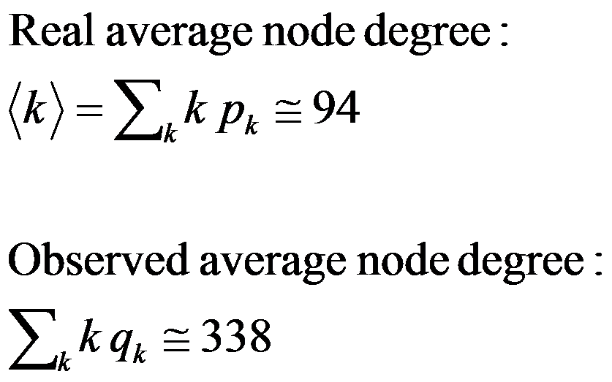
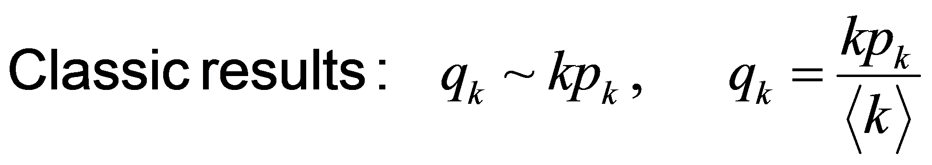
A walk in Facebook
q_{k} - observed node degree distribution
p_{k} - real node degree distribution

Slide 9


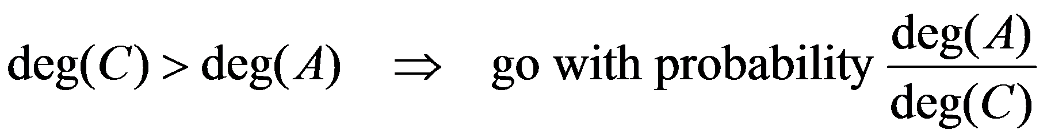
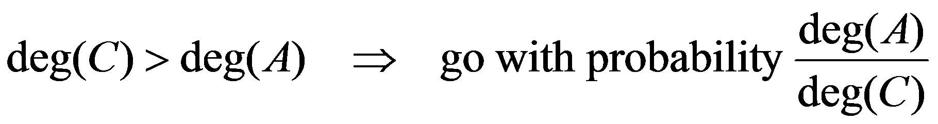
How to get an unbiased sample?
Metropolis-Hastings Random Walk (MHRW):
E
I
N
D
G
K
B
M
H
A
L
C
J
F
S =
D
A
A
C
…
…

Slide 10
How to get an unbiased sample?
Metropolis-Hastings Random Walk (MHRW):
Re-Weighted Random Walk (RWRW):
E
I
N
D
G
K
B
M
H
A
L
C
J
F
S =
D
A
A
C
…
Introduced in [Volz and Heckathorn 2008] in the context of Respondent Driven Sampling
Now apply the Hansen-Hurwitz estimator:
…
10

Slide 11
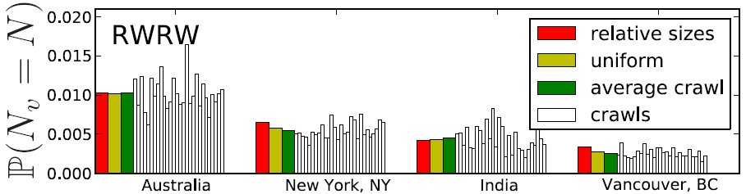
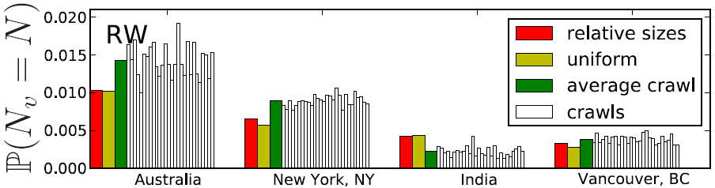
Facebook results
Metropolis-Hastings Random Walk (MHRW):
Re-Weighted Random Walk (RWRW):

Slide 12
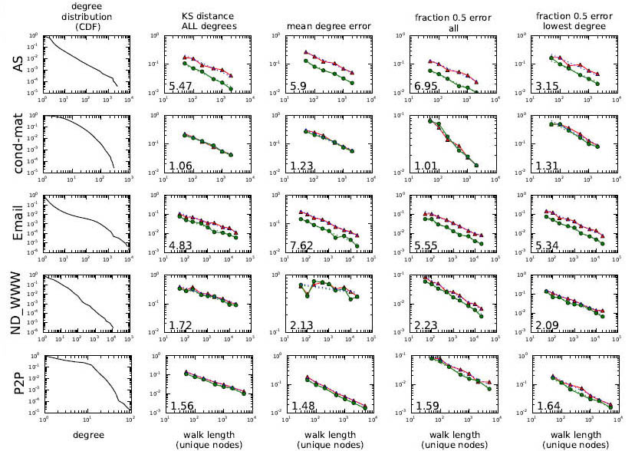

MHRW or RWRW ?
~3.0

Slide 13
MHRW or RWRW ?
RWRW > MHRW
(RWRW converges 1.5 to 6 times faster)
But MHRW is easier to use, because it does not require reweighting.
[1] Minas Gjoka, Maciej Kurant, Carter T. Butts and Athina Markopoulou, “Walking in Facebook: A Case Study of Unbiased Sampling of OSNs”, INFOCOM 2010.

Slide 14
RW extensions
1) Multigraph sampling

Slide 15
E
I
N
K
Friends
D
G
B
M
H
A
L
C
J
F
E
I
N
D
G
K
Events
B
M
H
A
L
C
J
F
E
I
N
D
G
K
B
M
Groups
H
A
L
C
J
E.g., in LastFM
F

Slide 16
E
I
N
K
Friends
D
G
B
M
H
A
L
C
J
F
E
I
N
D
G
K
Events
B
M
H
A
L
C
J
F
E
I
N
D
G
K
B
M
Groups
H
A
L
C
J
E.g., in LastFM
F

Slide 17
Multigraph sampling
E
I
N
D
G
K
G* = Friends + Events + Groups
( G* is a multigraph )
B
M
H
A
L
C
J
F
[2] Minas Gjoka, Carter T. Butts, Maciej Kurant, Athina Markopoulou,
“Multigraph Sampling of Online Social Networks”, arXiv:1008.2565.

Slide 18
RW extensions
2) Stratified Weighted RW

Slide 19
Not all nodes are equal
Node categories:
Stratification. Node weight is proportional to its sampling probability under Weighted Independence Sampler (WIS)
important
(equally) important
irrelevant

Slide 20
Not all nodes are equal
Node categories:
Stratification. Node weight is proportional to its sampling probability under Weighted Independence Sampler (WIS)
important
(equally) important
irrelevant
But graph exploration techniques have to follow the links!
Enforcing WIS weights may lead to slow (or no) convergence
We have to trade between fast convergence and ideal (WIS) node sampling probabilities

Slide 21
E.g., compare the size of red and green categories.
Measurement objective

Slide 22
E.g., compare the size of red and green categories.
Measurement objective
Theory of stratification
Category weights optimal under WIS

Slide 23
E.g., compare the size of red and green categories.
Measurement objective
Category weights optimal under WIS
Controlled by two intuitive and robust parameters
Modified category weights
Allocate small weight to irrelevant node categories
Limit the weight of tiny categories (to avoid “black holes”)

Slide 24
E.g., compare the size of red and green categories.
Measurement objective
Category weights optimal under WIS
Target edge weights
Modified category weights
20
=
22
=
4
=
Edge weights in G
Resolve conflicts:
arithmetic mean,
geometric mean,
max,
…

Slide 25
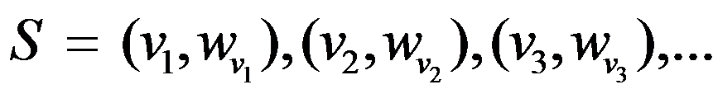
E.g., compare the size of red and green categories.
Measurement objective
Category weights optimal under WIS
Modified category weights
Edge weights in G
WRW sample

Slide 26
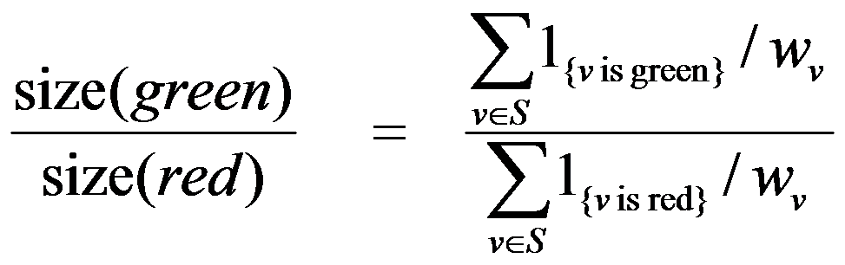
E.g., compare the size of red and green categories.
Measurement objective
Category weights optimal under WIS
Modified category weights
Edge weights in G
WRW sample
Hansen-Hurwitz estimator
Final result

Slide 27
E.g., compare the size of red and green categories.
Measurement objective
Category weights optimal under WIS
Stratified Weighted Random Walk (S-WRW)
Modified category weights
Edge weights in G
WRW sample
Final result

Slide 28
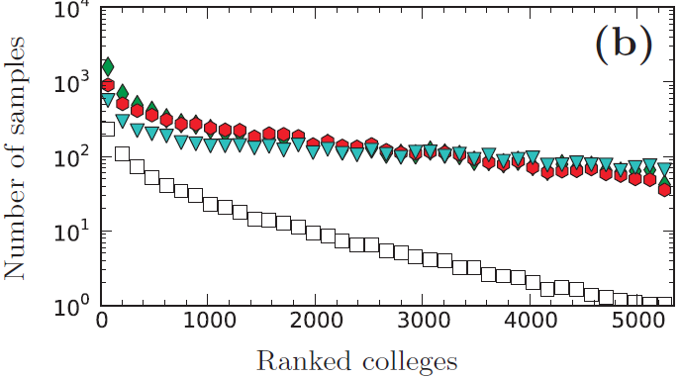
Colleges in Facebook
versions of S-WRW
Random Walk (RW)
3.5% of Facebook users are declare memberships in colleges
S-WRW collects 10-100 times more samples per college than RW
This difference is larger for small colleges – stratification works!
RW needs 13-15 times more samples to achieve the same error!
[3] Maciej Kurant, Minas Gjoka, Carter T. Butts and Athina Markopoulou,
“Walking on a Graph with a Magnifying Glass”, to appear in SIGMETRICS 2011.

Slide 29
Part 2:
What do we learn from our samples?

Slide 30
What can we learn from datasets?
Node properties:
  Community membership information
  Privacy settings
  Names
  …
Local topology properties:
  Node degree distribution
  Assortativity
  Clustering coefficient
  …

Slide 31
Example: Privacy Awareness in Facebook
What can we learn from datasets?
PA =
Probability that a user changes the default privacy settings

Slide 32
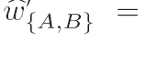
What can we learn from datasets?
Coarse-grained topology
B
A
Pr[ a random node in A and a random node in B are connected ]
number of sampled nodes
number of edges between node a and community B
number of nodes sampled in A
total number of nodes (estimated)
number of nodes sampled in B
nodes sampled in A
From a randomly sampled set of nodes we infer a valid topology!

Slide 33
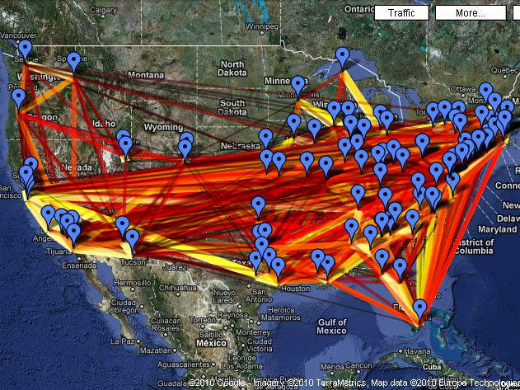
US Universities

Slide 34
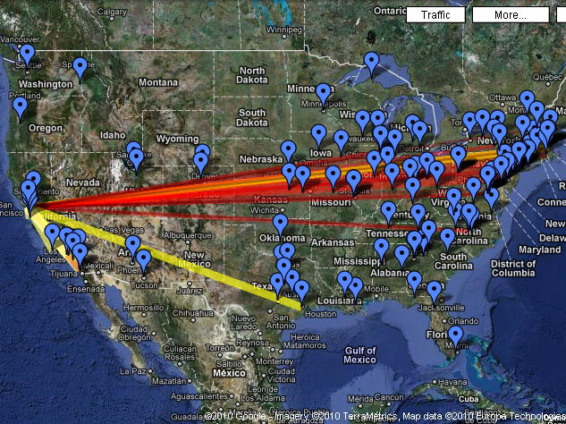
US Universities

Slide 35
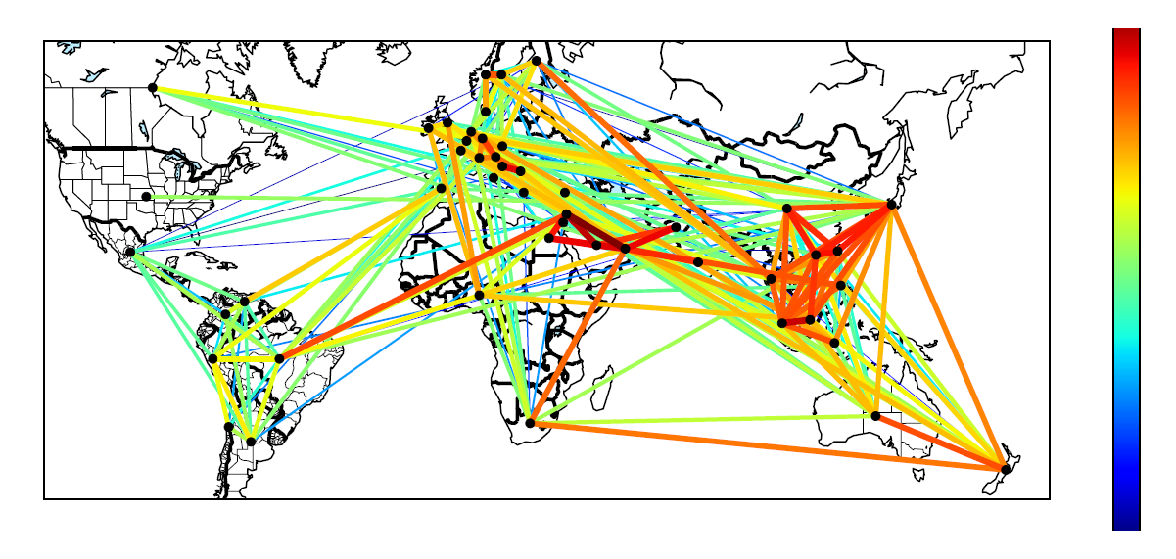
Country-to-country FB graph
Some observations:
  Clusters with strong ties in Middle East and South Asia
  Inwardness of the US
  Many strong and outwards edges from Australia and New Zealand

Slide 36
Lebanon
Jordan
Israel
Egypt
Saudi Arabia
Strong clusters among middle-eastern countries
United Arab Emirates

Slide 37
Part 3:
Sampling without repetitions:

Slide 38
Exploration without repetitions

Slide 39
Exploration without repetitions

Slide 40
Exploration without repetitions
Examples:
RDS (Respondent-Driven Sampling)
Snowball sampling
BFS (Breadth-First Search)
DFS (Depth-First Search)
Forest Fire
…

Slide 41
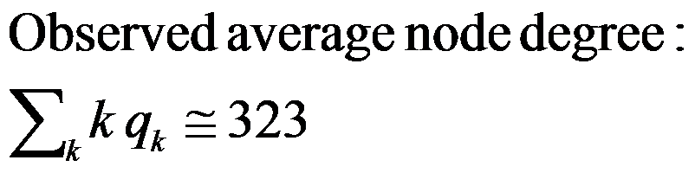
q_{k}
p_{k}
Why?

Slide 42
Graph model RG(p_{k})
Random graph RG(p_{k}) with a given node degree distribution p_{k}

Slide 43
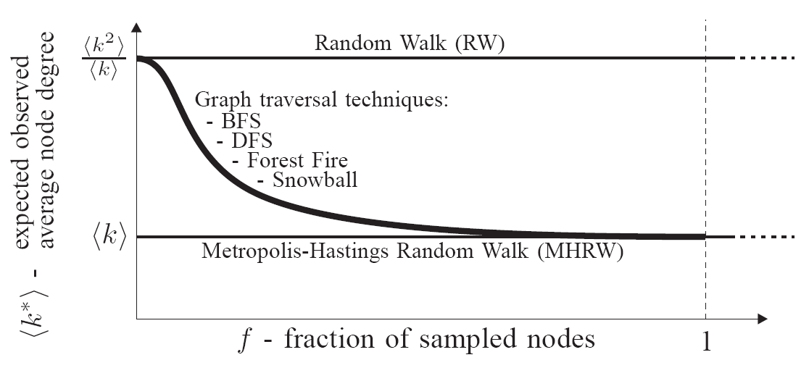

Solution (very briefly)
Graph traversals on RG(p_{k}):
MHRW, RWRW
- real average node degree
- real average squared node degree.

Slide 44

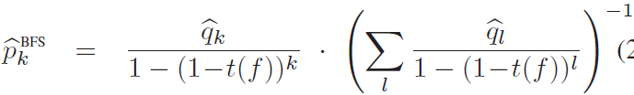
Solution (very briefly)
Graph traversals on RG(p_{k}):
RDS
MHRW, RWRW
expected bias
- real average node degree
- real average squared node degree.
corrected

Slide 45
Solution (very briefly)
For small sample size (for f→0),
BFS has the same bias as RW.
(observed in our Facebook measurements)
Graph traversals on RG(p_{k}):
RDS
For large sample size (for f→1), BFS becomes unbiased.
MHRW, RWRW
This bias monotonically decreases with f.
We found analytically the shape of this curve.
expected bias
- real average node degree
- real average squared node degree.
corrected

Slide 46
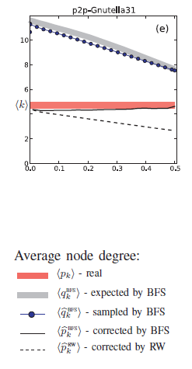
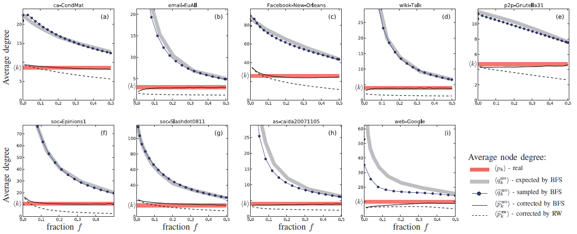
What if the graph is not random?
Current RDS procedure

Slide 47
Summary

Slide 48
  RWRW > MHRW [1]
  The first unbiased sample of Facebook nodes [1,6]
  Convergence diagnostics [1]
I
I
N
E
N
E
K
G
K
D
G
D
M
B
M
B
H
H
L
A
L
A
C
C
J
F
J
  Random Walks
F
  Multigraph sampling [2]
  Stratified WRW [3]
E
I
N
D
G
K
B
M
A
H
L
C
F
J
E
I
N
D
G
K
B
M
A
H
L
C
F
J
References
[1] M. Gjoka, M. Kurant, C. T. Butts and A. Markopoulou, “Walking in Facebook: A Case Study of Unbiased Sampling of OSNs”, INFOCOM 2010.
[2] M. Gjoka, C. T. Butts, M. Kurant and A. Markopoulou, “Multigraph Sampling of Online Social Networks”, arXiv:1008.2565
[3] M. Kurant, M. Gjoka, C. T. Butts and A. Markopoulou, “Walking on a Graph with a Magnifying Glass”, to appear in SIGMETRICS 2011.
[4] M. Kurant, A. Markopoulou and P. Thiran, “On the bias of BFS (Breadth First Search)”, ITC 22, 2010.
[5] M. Kurant, M. Gjoka, C. T. Butts and A. Markopoulou, “Estimating coarse-grained graphs of OSNs”, in preparation.
[6] Facebook data: http://odysseas.calit2.uci.edu/research/osn.html
[7] Python code for BFS correction: http://mkurant.com/maciej/publications

Slide 49
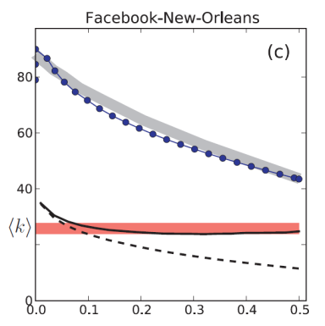
  RWRW > MHRW [1]
  The first unbiased sample of Facebook nodes [1,6]
  Convergence diagnostics [1]
E
I
N
D
G
K
B
M
A
H
L
C
F
J
  Random Walks
  Multigraph sampling [2]
  Stratified WRW [3]
Graph traversals on RG(p_{k}):
  [4,7]
MHRW, RWRW
  Traversals (no repetitions)
RDS
References
[1] M. Gjoka, M. Kurant, C. T. Butts and A. Markopoulou, “Walking in Facebook: A Case Study of Unbiased Sampling of OSNs”, INFOCOM 2010.
[2] M. Gjoka, C. T. Butts, M. Kurant and A. Markopoulou, “Multigraph Sampling of Online Social Networks”, arXiv:1008.2565
[3] M. Kurant, M. Gjoka, C. T. Butts and A. Markopoulou, “Walking on a Graph with a Magnifying Glass”, to appear in SIGMETRICS 2011.
[4] M. Kurant, A. Markopoulou and P. Thiran, “On the bias of BFS (Breadth First Search)”, ITC 22, 2010.
[5] M. Kurant, M. Gjoka, C. T. Butts and A. Markopoulou, “Estimating coarse-grained graphs of OSNs”, in preparation.
[6] Facebook data: http://odysseas.calit2.uci.edu/research/osn.html
[7] Python code for BFS correction: http://mkurant.com/maciej/publications

Slide 50
  RWRW > MHRW [1]
  The first unbiased sample of Facebook nodes [1,6]
  Convergence diagnostics [1]
E
I
N
D
G
K
B
M
A
H
L
C
F
J
  Random Walks
  Multigraph sampling [2]
  Stratified WRW [3]
Graph traversals on RG(p_{k}):
  [4,7]
MHRW, RWRW
  Traversals (no repetitions)
RDS
B
A
  [3,5]
  Coarse-grained topologies
References
[1] M. Gjoka, M. Kurant, C. T. Butts and A. Markopoulou, “Walking in Facebook: A Case Study of Unbiased Sampling of OSNs”, INFOCOM 2010.
[2] M. Gjoka, C. T. Butts, M. Kurant and A. Markopoulou, “Multigraph Sampling of Online Social Networks”, arXiv:1008.2565
[3] M. Kurant, M. Gjoka, C. T. Butts and A. Markopoulou, “Walking on a Graph with a Magnifying Glass”, to appear in SIGMETRICS 2011.
[4] M. Kurant, A. Markopoulou and P. Thiran, “On the bias of BFS (Breadth First Search)”, ITC 22, 2010.
[5] M. Kurant, M. Gjoka, C. T. Butts and A. Markopoulou, “Estimating coarse-grained graphs of OSNs”, in preparation.
[6] Facebook data: http://odysseas.calit2.uci.edu/research/osn.html
[7] Python code for BFS correction: http://mkurant.com/maciej/publications
  Thank you!

